Slide 2
Clinical Documentation Tip:
Urinary Tract Infections
Freddy Santoso, CCS, CCDS

Slide 3
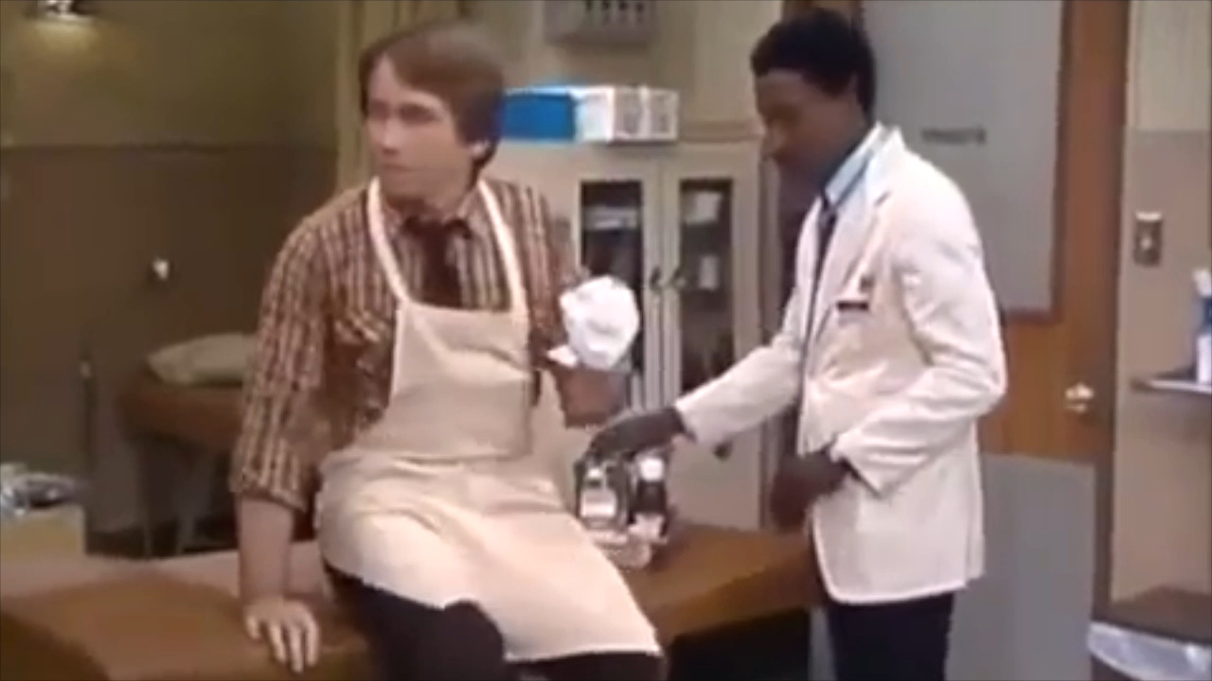
Misinterpretation...

Slide 4
Know Your Audience
“UA+, Start Cipro”
“UTI”
≠

Slide 5
Clinical Example – “Mr. Smith”
HPI: 53 y M with h/o C5 spinal injury presents from nursing facility with low grade fever and cloudy, malodorous urine in Foley bag
P/E: Temp 100.4 with suprapubic tenderness
Lab: Urine culture = 50-75K Proteus

Slide 6
Documentation Impact
POOR
GOOD
Cystitis
filler filler filler fillerfi
Expected Length of Stay = 3 Days
Acute cystitis associated with Foley catheter
Expected Length of Stay = 4 Days

Slide 7
Clinical Example – “Mrs. Smith”
HPI: 42 y female with diabetes presents with fever, nausea/vomiting, urinary frequency, urgency & pain
P/E: T max 101.5, HR 100, RR 22, BP 90/60, with left costovertebral angle tenderness
Lab: CBC = WBC 14; UA = LE 3+, nitrite+; Urine Culture = >100,000 CFU of E. Coli

Slide 8
Documentation Impact
POOR
GOOD
Pyelonephritis fillerfi
Expected Length of Stay = 3 Days
E. Coli Sepsis 2/2 Acute pyelonephritis
Expected Length of Stay = 4 Days

Slide 9
Documentation Impact
“Urosepsis”
Expected LOS = 0 days
“Pyelonephritis”
Expected LOS = 3 days
“Sepsis 2/2 Acute Pyelonephritis”
Expected LOS = 4 days
“Sepsis 2/2 Acute Pyelo 2/2 Foley”
Expected LOS = 5 days

Slide 10
Key Points
Specify Acuity of UTI (“acute cystitis” “acute pyelo”)
Link UTI to organism, if known
Link UTI to sepsis, if applicable (but avoid “urosepsis”)
Link UTI to indwelling device, if applicable (Foley/suprapubic catheter/nephrostomy tube)
Note: Useful phrases that LINK two conditions together -
“due to” “secondary to” “related to” “associated with”

Slide 11
THANK YOU !
ANY QUESTIONS ?

