Slide 1
Documentation Tips:
Pressure Ulcer

Slide 2
Penny & Quality For Your Thoughts …
“Pressure ulcer or Decubitus ulcer”
A pressure ulcer is a localized injury to the skin and/or underlying tissue usually over a bony prominence, as a result of pressure, or pressure in combination with shear.
Stage ( Stage I, Stage II, Stage III, Stage IV, Unstageable, DTPI(deep tissue pressure injury), see slides 7 to 9 for details.
Common Locations (sacrum/coccyx, hip, heel, buttocks, low back, elbow, shoulder)
Present on admission

Slide 3
Clinical Example – “Mr. Cooper”
HPI: 90 y Male from SNF, h/o CVA in 2016 with left hemiparesis and vascular dementia, presents with increasing purulent drainage from sacral pressure ulcer stage III and reported Temp of 102.5F at the SNF.
P/E: Temp= 102F BP = 92/62 mm Hg, HR = 120 RR =23
Lab: WBC= 18.6 Lactic acid = 2.8 Cr 1.8 from baseline 1.2
Blood and sacral wound cultures returned positive for MRSA.
Rx: IV Vancomycin, IV Fluids, Wound care

Slide 4
Documentation Impact
GOOD
POOR
Sepsis
DQ ulcer
Decub ulcer
Sacral wound
Sacral Pressure ulcer
MRSA Bacteremia
Expected Length of Stay = 3.7 Days
Sepsis due to MRSA bacteremia and infected sacral pressure ulcer stage III, present on admission (PDx/MCC)
Acute kidney failure or acute renal failure or acute kidney injury (CC)
Left hemiparesis s/p CVA in 2016 (CC)
Vascular Dementia s/p CVA in 2016
Expected Length of Stay = 4.9 Days

Slide 5
Pressure Ulcer Documentation Best Practice
ALWAYS DOCUMENT:
Type of Ulcer (pressure or decubitus)
Location and Laterality ( ex. Right heel, Right elbow, sacrum)
Stage (DTPI, Stage I, Stage II, Stage III, Stage IV, Unstageable)
Present on admission
QI Web Site: qualityindicators.ahrq.gov (PRESSURE ULCER IS A PATIENT SAFETY INDICATOR #3)
The Patient Safety Indicators (PSIs) are a set of indicators providing information on potential in hospital complications and adverse events following surgeries, procedures, and childbirth
PSIs can be used to help hospitals identify potential adverse events that might need further study; provide the opportunity to assess the incidence of adverse events and in hospital complications using administrative data found in the typical discharge record; include indicators for complications occurring in hospital that may represent patient safety events; and, indicators also have area level analogs designed to detect patient safety events on a regional level

Slide 6
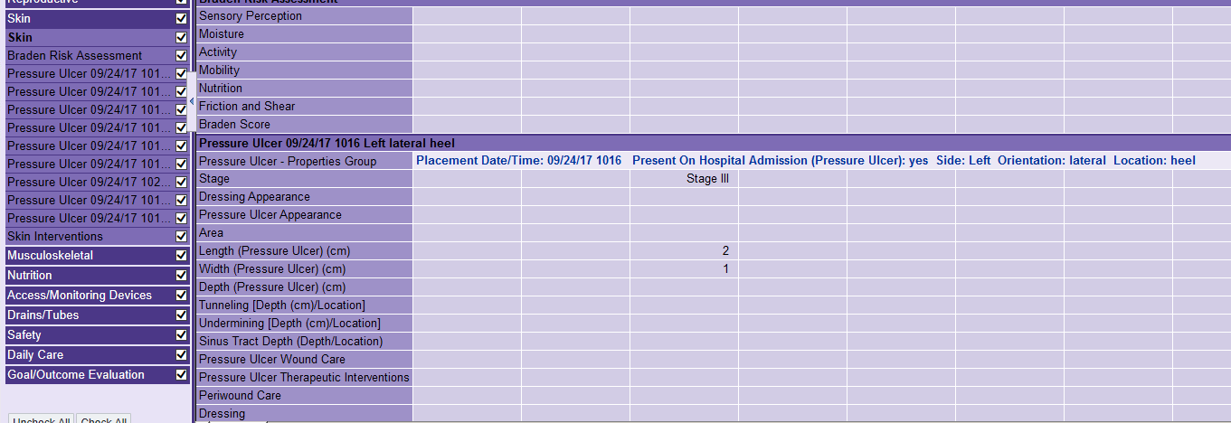
Key Points
Nursing documentation of pressure ulcer or wounds can be found from:
Wound nurse notes, or
Nursing flowsheet “ adult patient care summary” section “skin”

Slide 7
Pressure Ulcer Stages/Categories
(National Pressure Ulcer Advisory Panel) www.npuap.org
Deep Tissue Pressure Injury
Unstageable Pressure Injury
Persistent non-blanchable deep red, maroon or purple discoloration.
Intact or non-intact skin with localized area of persistent non-blanchable deep red, maroon, purple discoloration or epidermal separation revealing a dark wound bed or blood filled blister. Pain and temperature change often precede skin color changes. Discoloration may appear differently in darkly pigmented skin. This injury results from intense and/or prolonged pressure and shear forces at the bone-muscle interface. The wound may evolve rapidly to reveal the actual extent of tissue injury, or may resolve without tissue loss. If necrotic tissue, subcutaneous tissue, granulation tissue, fascia, muscle or other underlying structures are visible, this indicates a full thickness pressure injury (Unstageable, Stage 3 or Stage 4). Do not use DTPI to describe vascular, traumatic, neuropathic, or dermatologic conditions.
Obscured full-thickness skin and tissue loss
Full-thickness skin and tissue loss in which the extent of tissue damage within the ulcer cannot be confirmed because it is obscured by slough or eschar. If slough or eschar is removed, a Stage 3 or Stage 4 pressure injury will be revealed. Stable eschar (i.e. dry, adherent, intact without erythema or fluctuance) on the heel or ischemic limb should not be softened or removed.

Slide 8
Pressure Ulcer Stages/Categories Continued
Stage I: Non-blanchable erythema of intact skin
Stage II: Partial-thickness skin loss with exposed dermis
Intact skin with a localized area of non-blanchable erythema, which may appear differently in darkly pigmented skin. Presence of blanchable erythema or changes in sensation, temperature, or firmness may precede visual changes. Color changes do not include purple or maroon discoloration; these may indicate deep tissue pressure injury.
Partial-thickness loss of skin with exposed dermis. The wound bed is viable, pink or red, moist, and may also present as an intact or ruptured serum-filled blister. Adipose (fat) is not visible and deeper tissues are not visible. Granulation tissue, slough and eschar are not present. These injuries commonly result from adverse microclimate and shear in the skin over the pelvis and shear in the heel. This stage should not be used to describe moisture associated skin damage (MASD) including incontinence associated dermatitis (IAD), intertriginous dermatitis (ITD), medical adhesive related skin injury (MARSI), or traumatic wounds (skin tears, burns, abrasions).

Slide 9
Pressure Ulcer Stages/Categories Continued
Stage III: Full-thickness skin loss
Stage IV: Full-thickness skin and tissue loss
Full-thickness loss of skin, in which adipose (fat) is visible in the ulcer and granulation tissue and epibole (rolled wound edges) are often present. Slough and/or eschar may be visible. The depth of tissue damage varies by anatomical location; areas of significant adiposity can develop deep wounds. Undermining and tunneling may occur. Fascia, muscle, tendon, ligament, cartilage and/or bone are not exposed. If slough or eschar obscures the extent of tissue loss this is an Unstageable Pressure Injury.
Full-thickness skin and tissue loss with exposed or directly palpable fascia, muscle, tendon, ligament, cartilage or bone in the ulcer. Slough and/or eschar may be visible. Epibole (rolled edges), undermining and/or tunneling often occur. Depth varies by anatomical location. If slough or eschar obscures the extent of tissue loss this is an Unstageable Pressure Injury.
Reference:
www.npuap.org
NPUAP Pressure Injury Stages
NPUAP Position Statement on Staging – 2017 Clarifications , January 24, 2017

