Slide 2
Clinical Documentation Tip:
Atrial Fibrillation
Freddy Santoso, CCS, CCDS

Slide 3
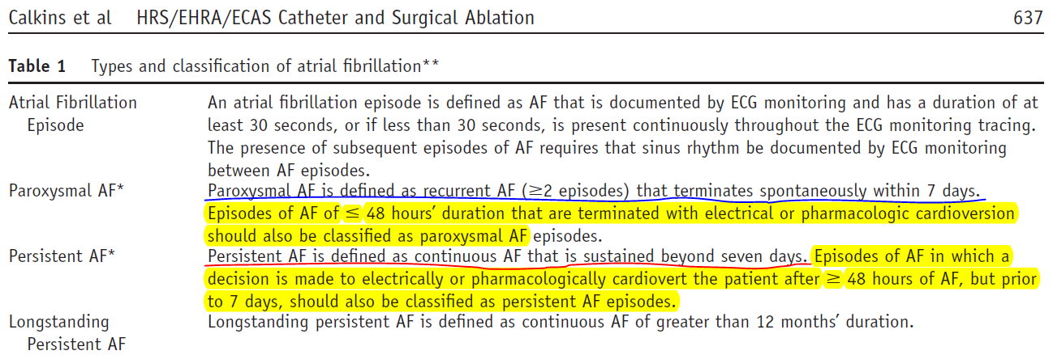
Definitions

Slide 4
Clinical Example – “Mr. Smith”
HPI: 88 y M with h/o HTN, dysphagia admitted with dyspnea and productive cough. Overnight developed Afib with RVR
P/E: Tachycardia to 140s
Lab: EKG = Afib; CXR = RLL consolidation
Rx: Antibiotics started on admit. Metoprolol, diltiazem, amiodarone bolus/gtt without good response x7 days; started apixaban; Cards consult - family declined any TEE/cardioversion or ablation as patient asymptomatic

Slide 5
Documentation Impact
POOR
GOOD
Aspiration PNA
“AFib w/ RVR”
filler filler filler fillerfi
Expected Length of Stay = 3 Days
Aspiration PNA
Persistent Afib w/ RVR
Expected Length of Stay = 5 Days

Slide 6
Clinical Example – “Mrs. Smith”
HPI: 55 y F no significant PMH p/w SOB, chest tightness x 2 weeks.
P/E: Tachycardia 140s-160s. BMI 44
Lab: EKG: Afib
Rx: Metoprolol, diltiazem uptitrated to no effect; day #2 Cardiology consult; heparin started; underwent successful DC cardioversion day #4

Slide 7
Documentation Impact
POOR
GOOD
“Afib w/ RVR”
“BMI 44”
Expected Length of Stay = 2 Days
Persistent Afib
Morbid obesity with BMI 44
Expected Length of Stay = 3 Days

Slide 8
Key Points
Avoid “Afib” or “pAF” – nonspecific/ambiguous
Use “paroxysmal” if < 7 days
Use “persistent” if > 7 days or if > 48 hours + decision to cardiovert (electrically or pharmarcologically)
Use “longstanding persistent” if > 12 months (not just ‘longstanding’)

Slide 9
THANK YOU !
ANY QUESTIONS ?

