Slide 1
Useful outpatient knowledge for categorical residents & interns
This Powerpoint will cover 6 useful points that you should know for IM clinic:
How to find your clinic schedule in healthlink
How to place schedule requests for clinic
How to close your clinic note and route it to your attending
Coverage Pods → How to grant access to your in basket and attach it to other residents
How to review in-baskets of fellow residents
Out of office notifications

Slide 2
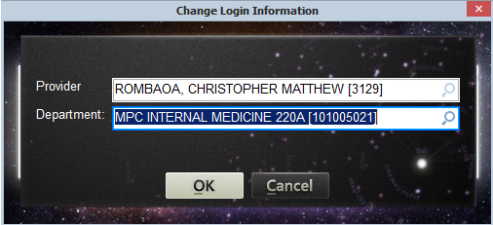
1. How to find your clinic schedule in healthlink
When you login to healthink, ensure that you have entered your specific side of Moorpark Clinic (MPC 220A or 220B)

Slide 3
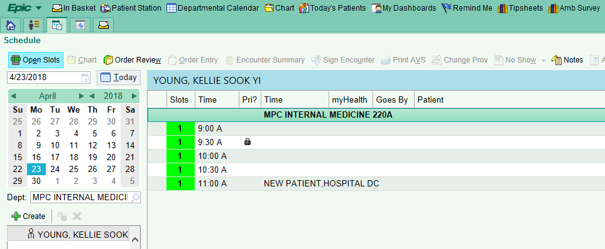
1. How to find your clinic schedule in healthlink
Click the icon in the top left.
Click the “Open Slots” tab
Click the specific date that you are scheduled to have clinic
Click your name to find your schedule
  You will be able to see open and filled spots for that day
1
2
3
4

Slide 4
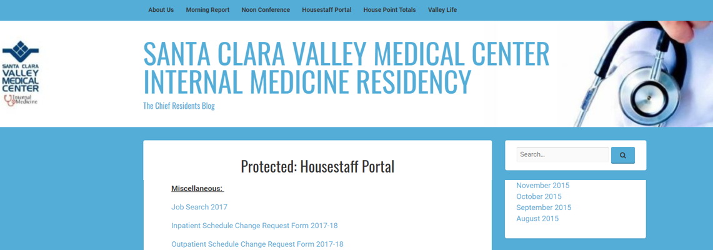
2. How to place schedule requests for clinic
Go to the Chief Blog (www.scvmcmed.com) and click on housestaff portal
Scroll down under miscellaneous and download the outpatient schedule change request form
  Requests must be turned in 120 days in advance due to the complex nature of scheduling patient panels

Slide 5
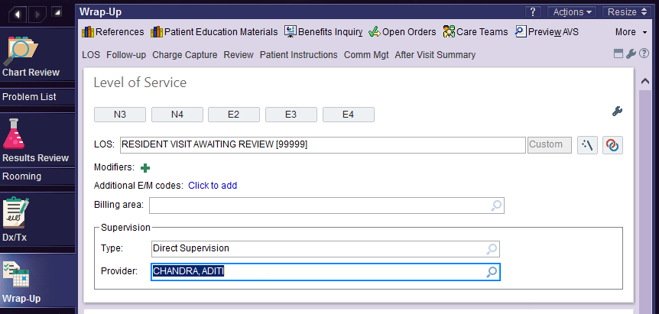
3. How to close your clinic note and route it to your attending
When you are done with your note and ready to close your encounter, click wrap-up on the left side
In the LOS (level of service) dialogue box, type “99999” → This routes it to your attending
The encounter type is “direct supervision”
  Be sure to type the name of your attending in the provider box before you submit
  Please ensure that your clinic notes are completed on the same day as the encounter
2
3
1

Slide 6
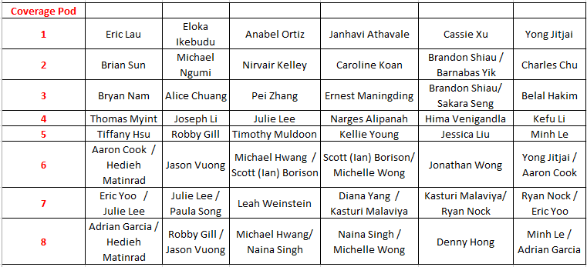
4. Coverage Pods → How to grant access to your in-basket and attach
it to your colleagues
Each coverage pod is comprised of 6-7 interns or residents.
People in the same row as you are in the same pod
  Notice that your name may be in more than 1 row

Slide 7
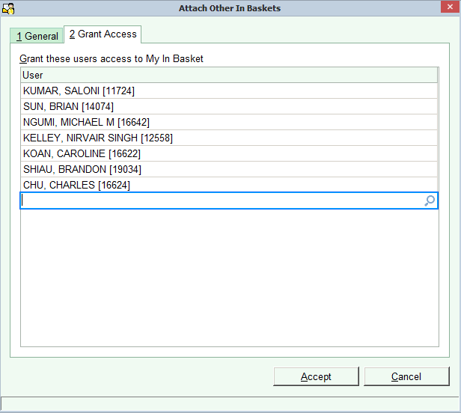
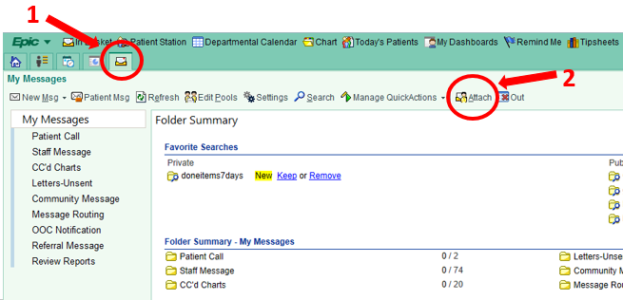
4. Coverage Pods → How to grant access to your in-basket and attach
it to your colleagues
Click the icon to get to your in-basket
Click the “Attach” tab
Click the “Grant Access” tab
  Add all 6 people in your coverage pod to grant them access
  to your inbox
3

Slide 8
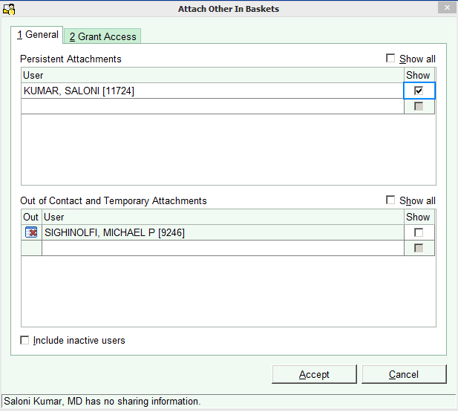
4. Coverage Pods → How to grant access to your in-basket and attach
it to your colleagues
4. Click the “General” tab to check who has given you access to their in-basket
  Type in the names of the 6 people in your coverage pod
  If a name cannot be added, your colleague has not yet granted you access. Come back later to add them after they do so.
4
The checkboxes in the “Show” column should be checked only when you are covering that person. Otherwise, your inbox will always be flooded by your colleagues’ results.

Slide 9
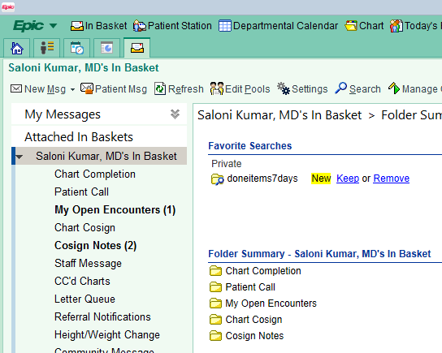
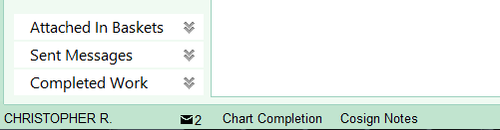
5. How to review in-baskets of fellow residents
In your in-basket, click the “Attached In Baskets” tab on the left hand side
Click the name of the colleague to check their in-basket
1
2

Slide 10
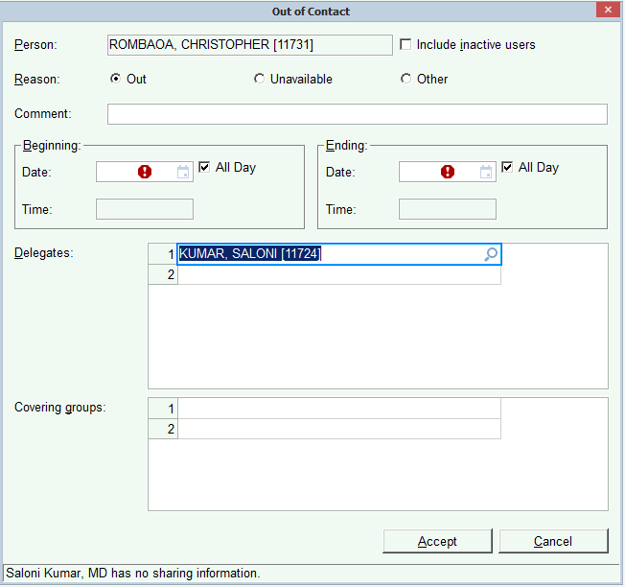
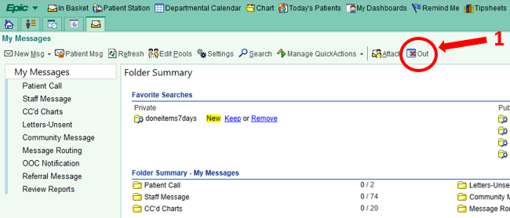

6. Out of office notifications
3
In your inbox, click the “out” tab
On the bottom left, click “+new”
In the out of contact box, fill in your away message,
Beginning/ending date, and colleague who will be covering you
2

Slide 11
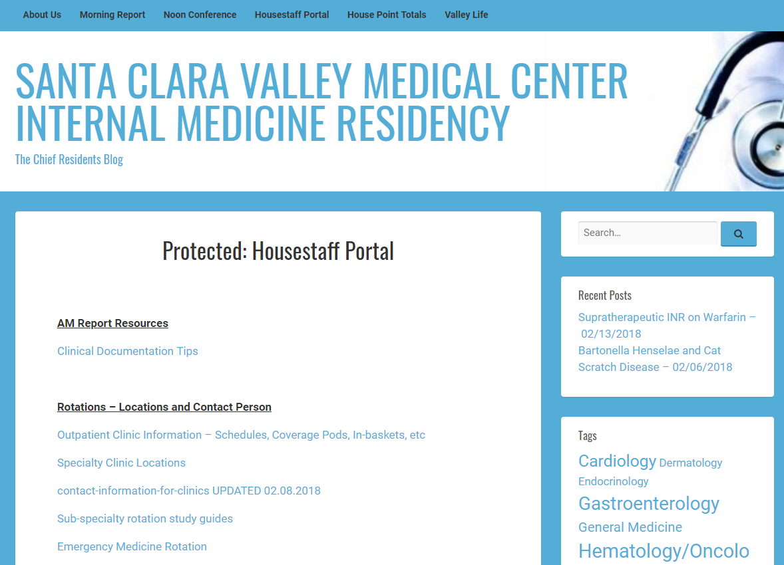
Need to review any of these instructions?
Check the Chief Blog under the house staff portal!

