Slide 1
“How to ECG”
Charles S. Smith, MD, FACC
Cardiology Division
Santa Clara Valley Medical Center
Notes:
How to Excel in your Cardiac Game! ☺

Slide 2
Contents
Reference slides
ECG Vignettes:
  “Found Down”
  “My Heart is Racing”
  “Getting Slow”
  “VT or Not VT…”
  “My Chest Hurts”
  “Random Stuff”

Slide 3
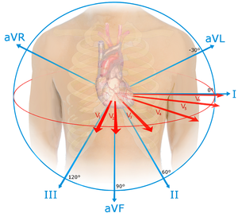

Slide 4
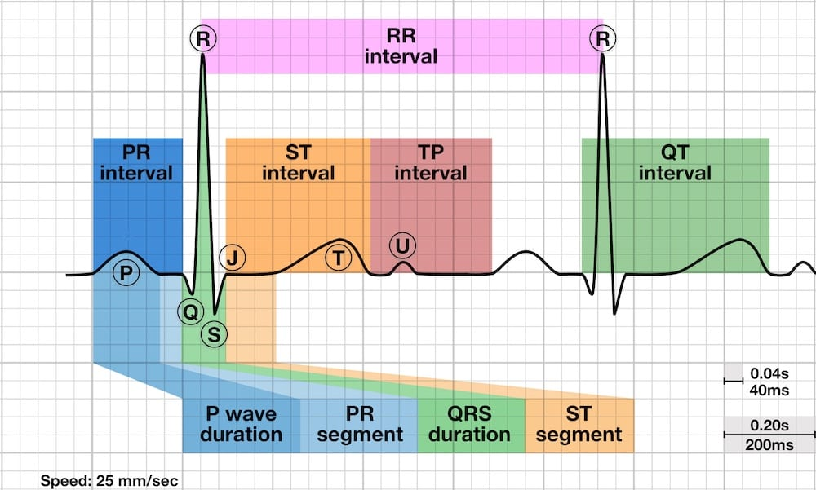

Slide 5
Reference Tracings
LVH
LBBB
RBBB

Slide 6
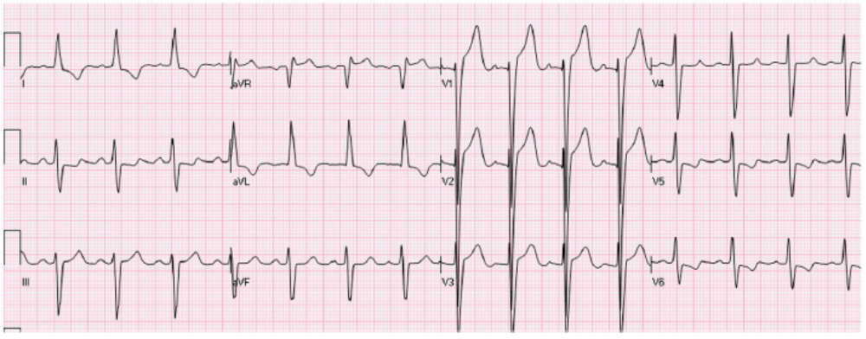
Left Ventricular Hypertrophy

Slide 7
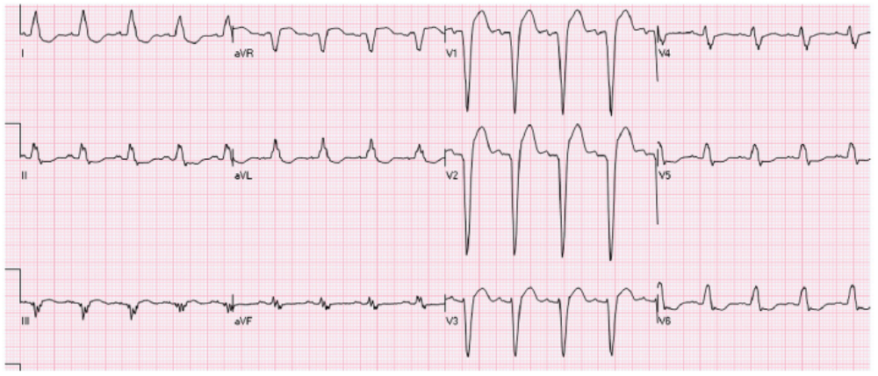
Left Bundle Branch Block

Slide 8
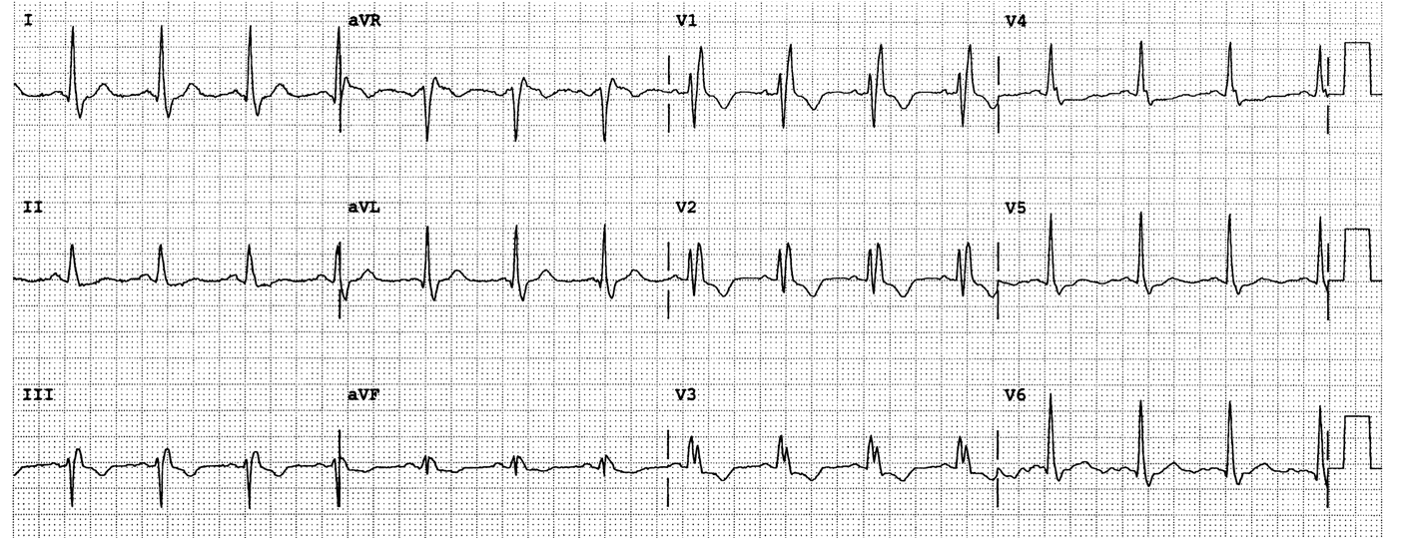
Right Bundle Branch Block

Slide 9
References: My Picks
Book: The Complete Guide to ECGs; James O’Keefe
Website: Life in the Fastlane, ECG part https://litfl.com/ecg-library/

Slide 10
“Found Down”

Slide 11
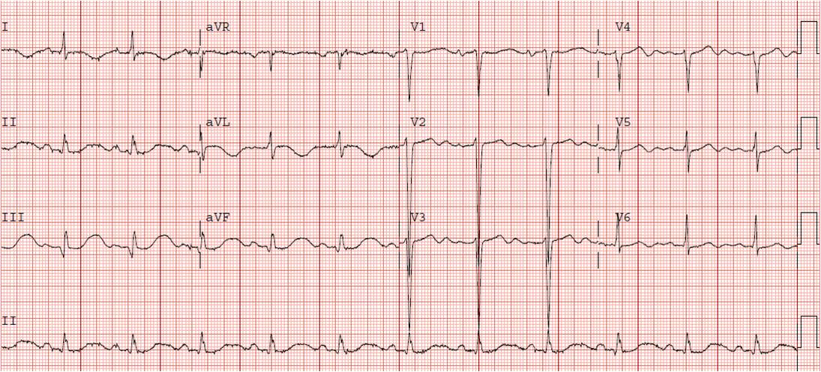
60/F found down, brought in after AED shock. What is the best treatment?
Emergent hemodialysis
Aspirin and intravenous heparin
Primary percutaneous coronary intervention
Oral and intravenous potassium chloride

Slide 12
Hypokalemia
Can see ST depression/T wave inversion
Apparent long QT due to T-U fusion
Prominent U waves
Can see enlargement/widening of P wave

Slide 13
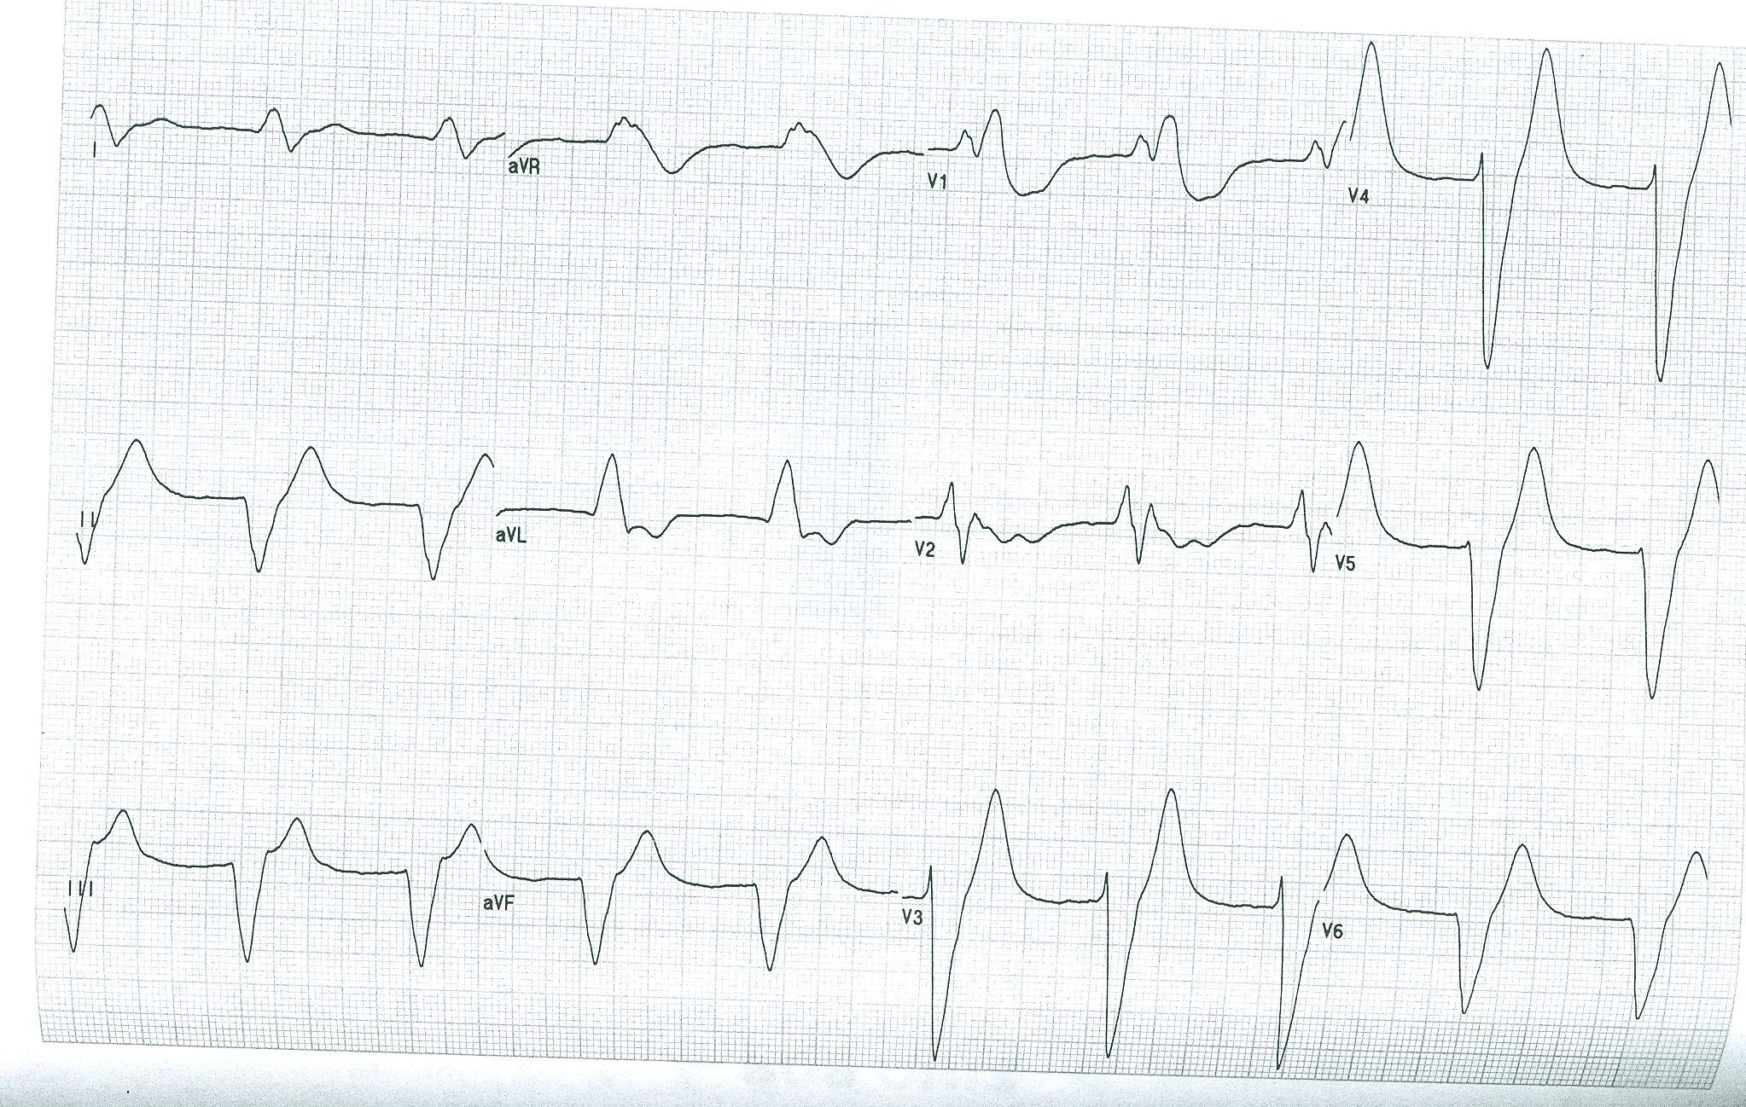
80/F found down. What is the likely diagnosis?
Hyperkalemia
Acute myocardial infarction
Intracerebral hemorrhage
Tricyclic antidepressant overdose

Slide 14
Hyperkalemia
Peaked T
Prolonged PR
Wide QRS
Flat P

Slide 15
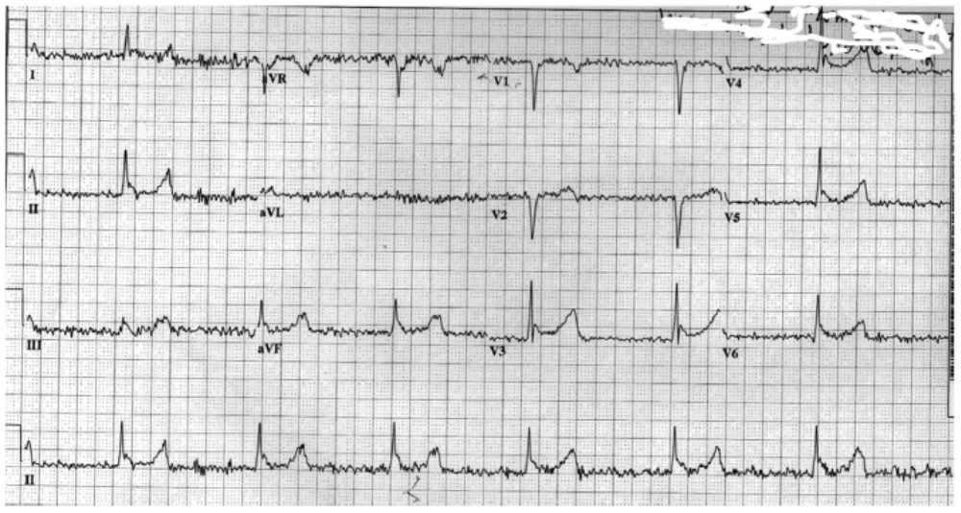
38/M found down; what is the next best step in management?
Pacemaker for atrial fibrillation with complete heart block
Rewarming
Emergency coronary angiography
IV calcium gluconate

Slide 16
Hypothermia
J waves (Osborn waves)
Note shivering artifacts

Slide 17
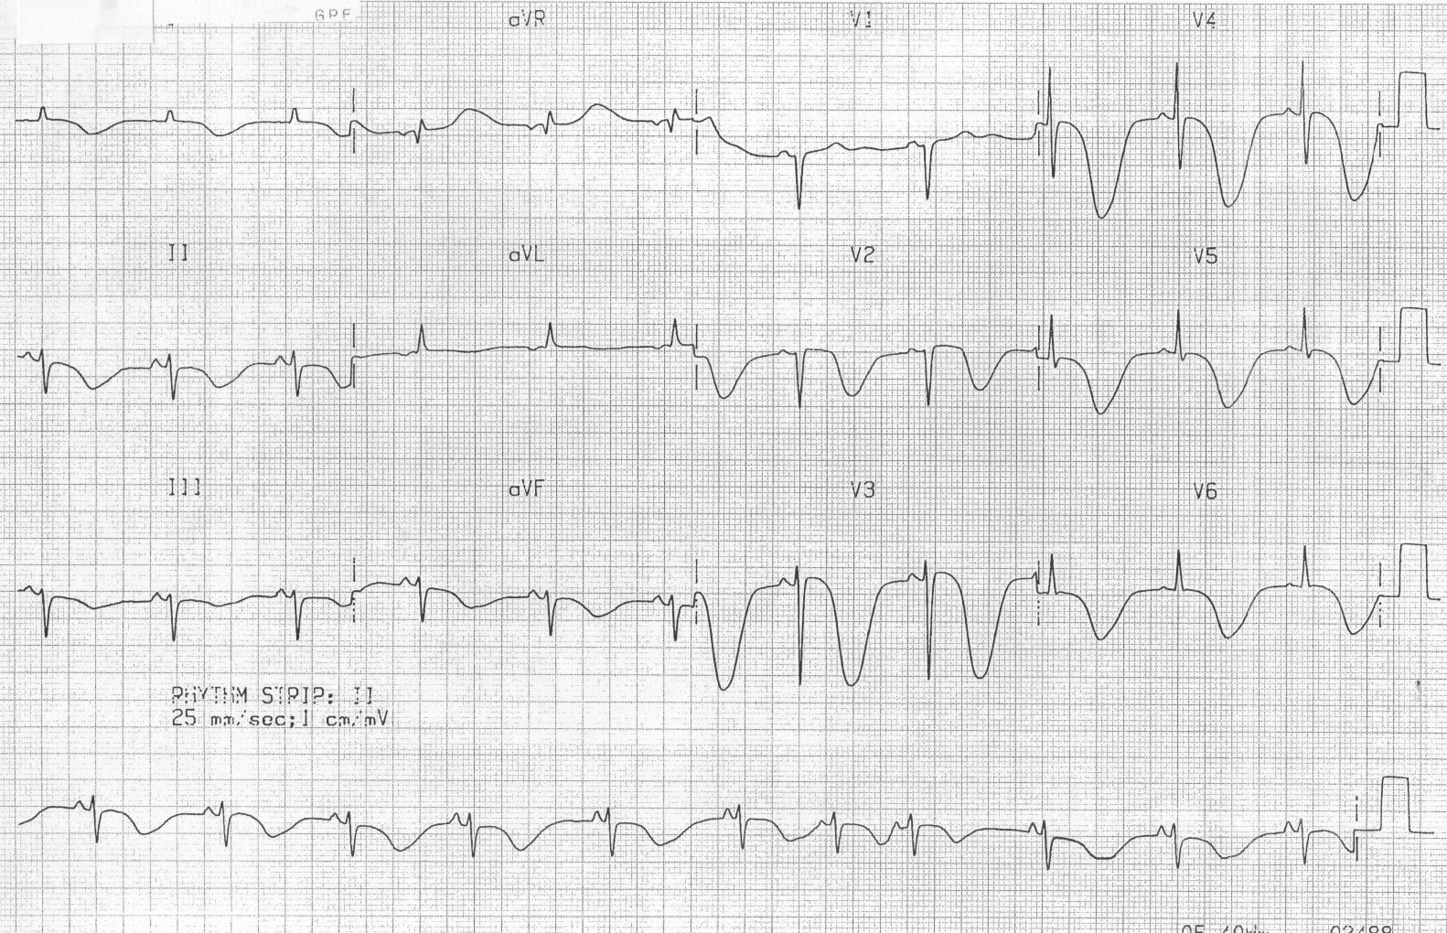
88/F found down, unresponsive. What is the most appropriate diagnostic test?
Echocardiogram
CT scan of the head
Coronary angiogram
Vasodilator stress test with myocardial perfusion imaging

Slide 18
“Cerebral T Waves”
Reported with hemorrhage and ischemic stroke
Other ECG findings in stroke:
  QT prolongation
  Less prominent T wave inversion or flattening
  ST segment changes (usually depression)
  New Q waves (often unrelated to coincident acute MI)
  Prominent U waves
  Various arrhythmias (most commonly, atrial fibrillation)

Slide 19
“My Heart is Racing”

Slide 20
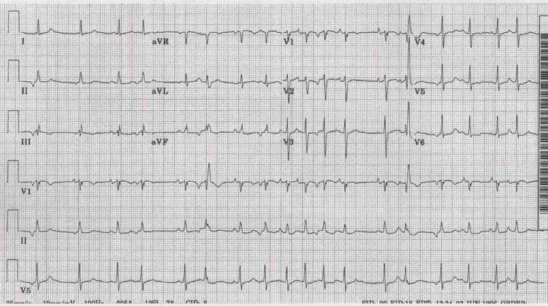
The arrhythmia above is most often associated with:
Pulmonary disease
Hypermagnesemia
Hypertension and older age
Myocardial infarction

Slide 21
Multifocal Atrial Tachycardia
Rate > 100 bpm
Varying PP, PR, RR intervals
At least 3 different P wave morphologies
Common disease associations: Pulmonary disease, heart failure, hypomagnesemia, hypokalemia

Slide 22
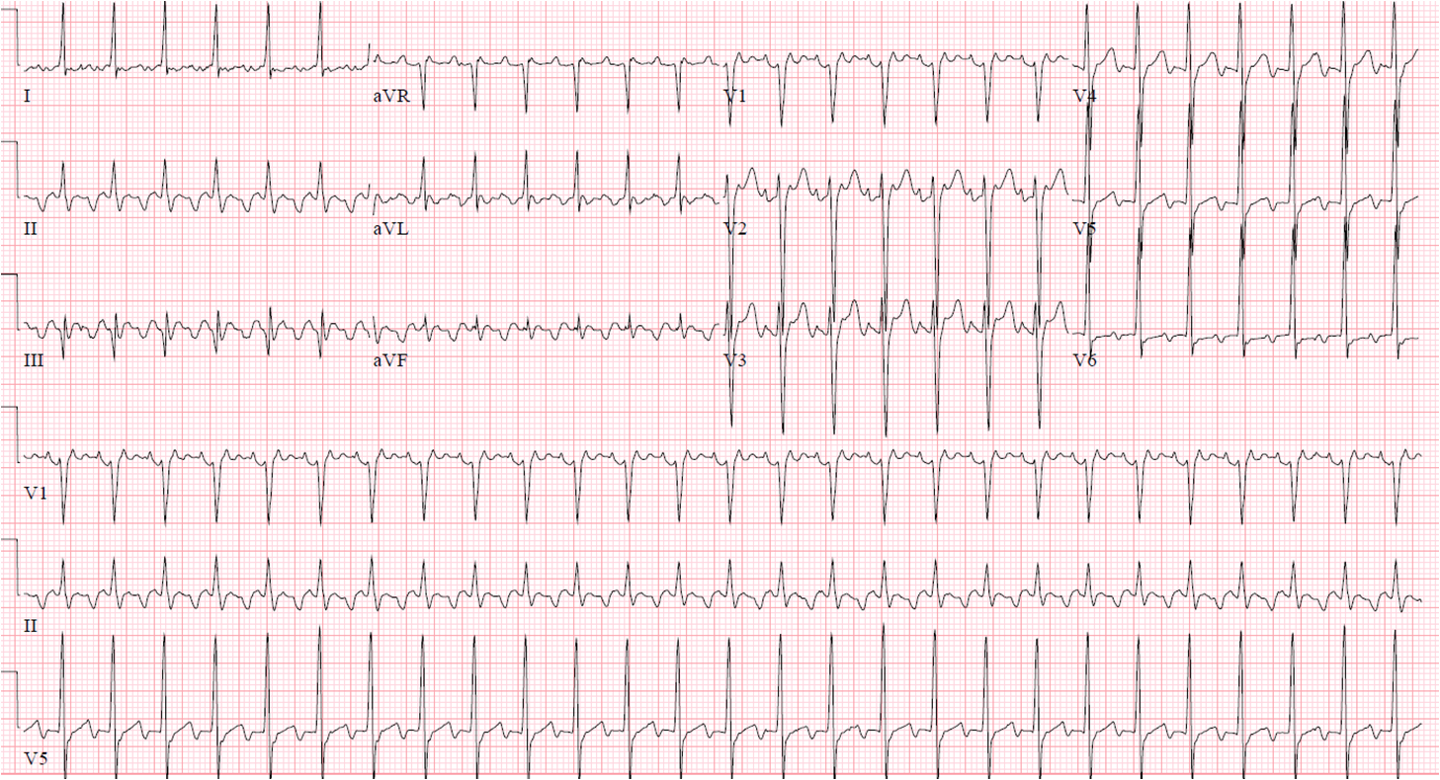
Which of the following is true regarding this arrhythmia?
Oral anticoagulation is not needed in the vast majority of cases, due to low risk of systemic embolization
There is a low rate of recurrence after cardioversion
Rate control is the best treatment option in most cases
Radiofrequency ablation is curative in over 95% of cases

Slide 23
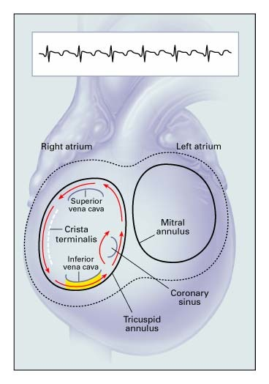
Atrial Flutter
“Sawtooth” negative f waves best seen in inferior leads
Positive or biphasic f waves in V1
Macro-reentry circuit in right atrium (cavotricuspid isthmus dependent)

Slide 24
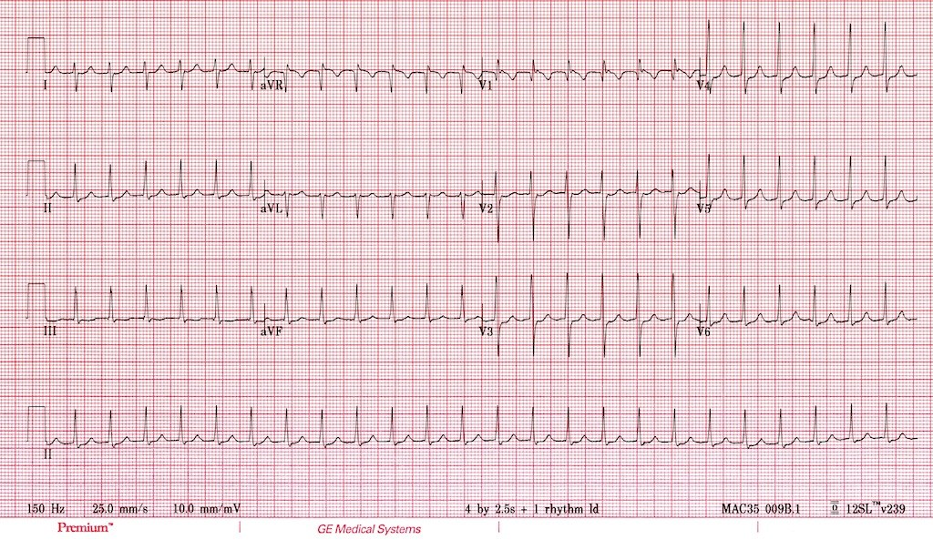
The rhythm abnormality shown is:
Sinus tachycardia
Atrioventricular nodal reentry tachycardia (AVNRT)
Atrial fibrillation
Atrial flutter

Slide 25
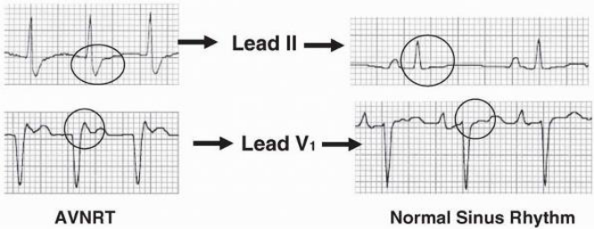
AVNRT
Retrograde p waves in typical AVNRT are often buried at the end of the QRS complex, and may appear as pseudo-R’ or pseudo-S waves

Slide 26
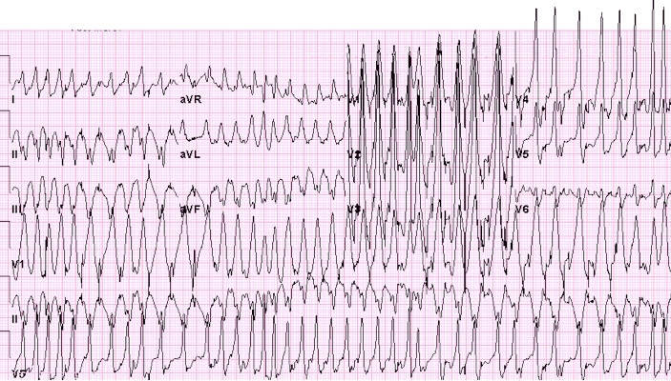
The rhythm abnormality shown:
Is associated with a high risk of sudden death
Is best treated with electrical cardioversion in the hemodynamically unstable patient
Should not be treated with agents that block the AV node
A, B, and C.

Slide 27
Atrial Fibrillation with Pre-Excitation (WPW)
This just looks awful!
Varying degrees of bypass tract conduction depending on R-R intervals (delta waves/QRS complexes vary in width)
Do NOT block the AV node!

Slide 28
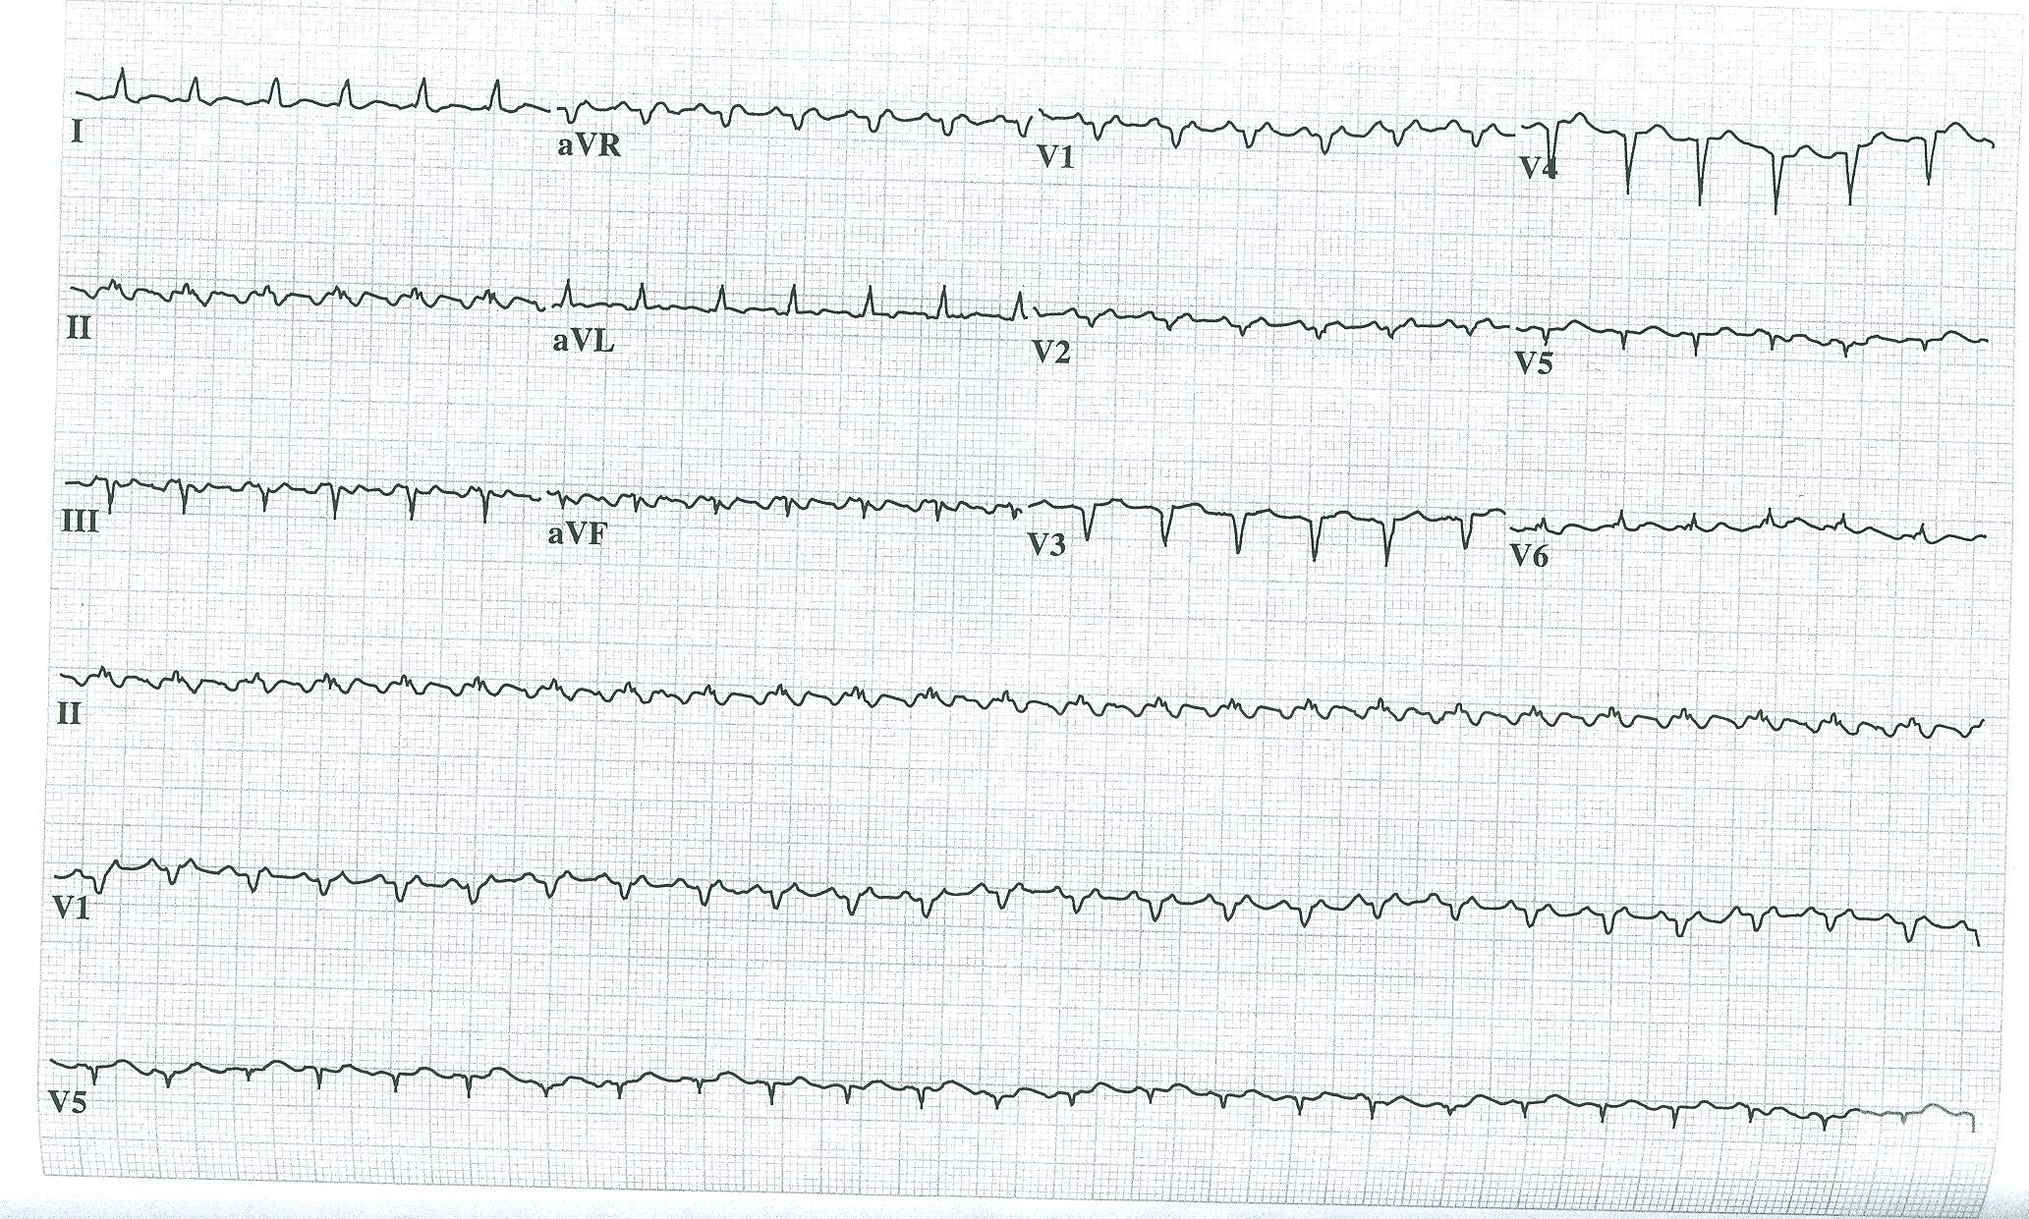
56/F with breast cancer and dyspnea. What is the most likely diagnosis?
Pericardial effusion and tamponade
Acute inferior myocardial infarction
Hypercalcemia
AL amyloidosis

Slide 29
Pericardial Effusion/Tamponade
Tachycardia (what type?) with low QRS voltages
Subtle electrical alternans

Slide 30
“Getting Slow”

Slide 31
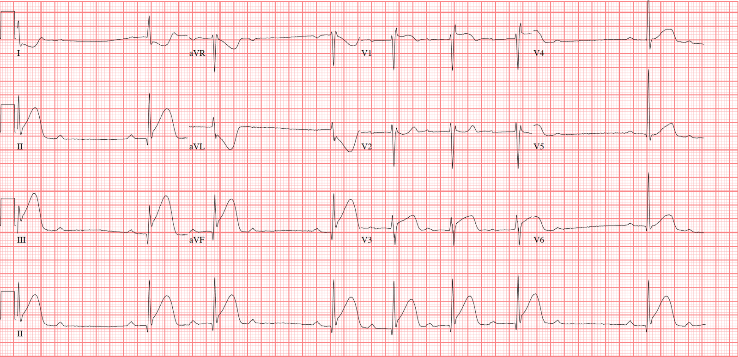
The rhythm abnormality shown is best treated with:
Emergency placement of a permanent pacemaker
Emergency coronary reperfusion
Beta blockers
Intravenous isoproterenol

Slide 32
Acute Inferior MI and Type 1 Second Degree AV Block
STE in V1 suggests RV infarct
STE in inferior leads
Suspect when you see grouped beating
Always check PR interval before and after the block (always longest right before, shortest right after)

Slide 33
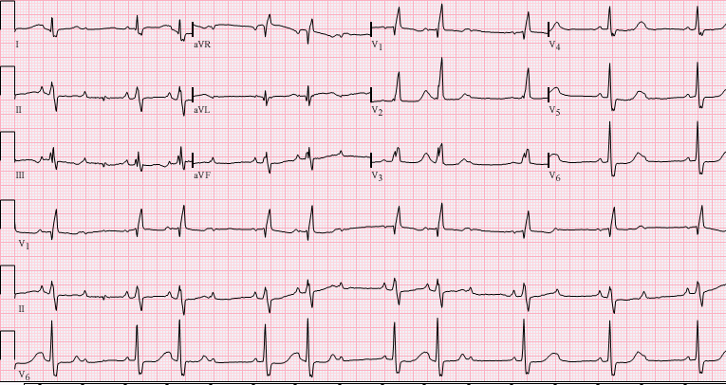
Mobitz II second deg AVB ecg
The rhythm abnormality shown is:
Atrial bigeminy
Type 1 (Wenckebach) second degree atrioventricular block
Type 2 second degree atrioventricular block
Type 2 (Wenckebach) sinoatrial nodal exit block

Slide 34
Type 2 Second Degree AV Block
Grouped beating with dropped QRS after P wave
PR intervals are constant

Slide 35
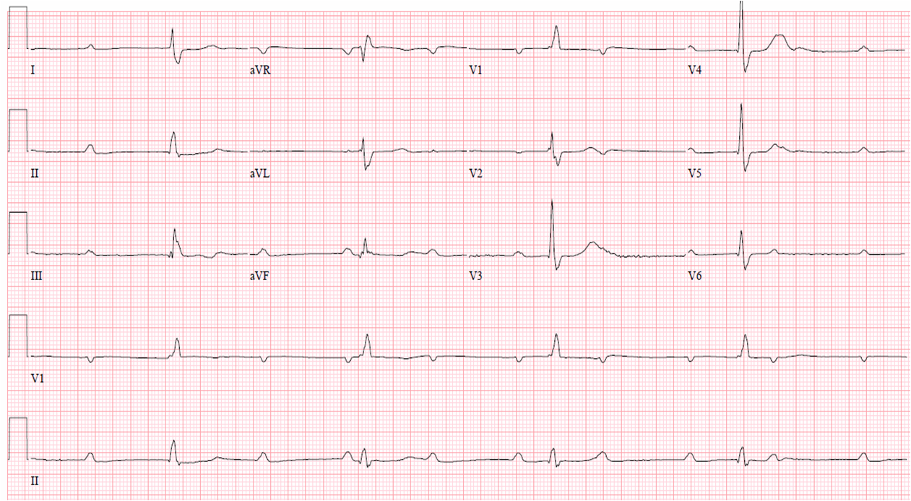
37/M asymptomatic, recently diagnosed with Lyme disease has the ECG above; what is the next best step in management?
Intravenous ceftriaxone
Oral doxycycline
Permanent pacemaker implantation
Initiate transcutaneous pacing

Slide 36
Complete Heart Block
P waves march through and do not conduct to the ventricle
Faster atrial rate than ventricular rate
Key Points:
  Remember reversible causes of complete heart block (permanent pacing not indicated)
  Not all AV dissociation is complete heart block

Slide 37
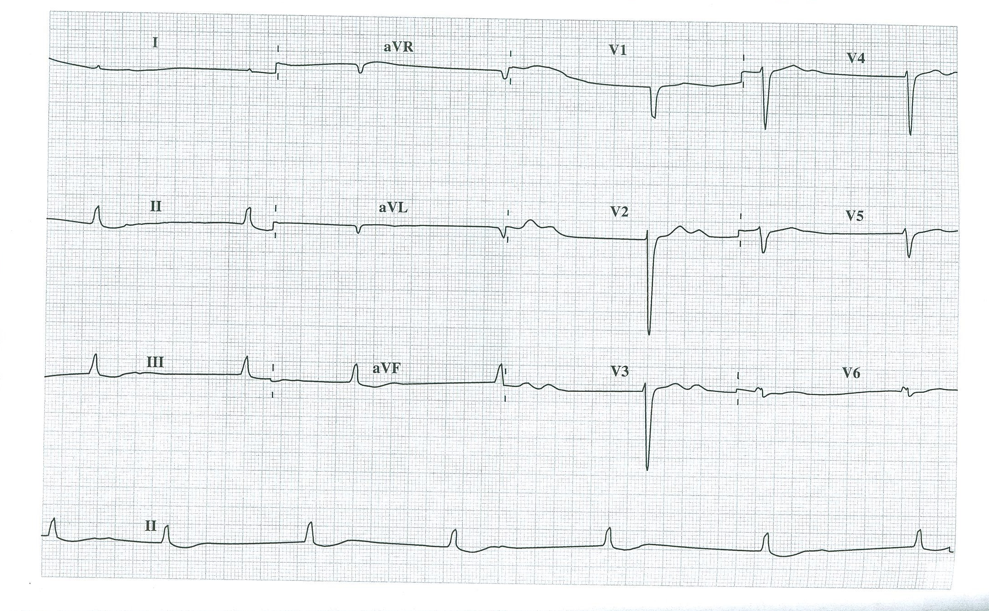
68/M with fatigue, dyspnea, and altered mentation. Serum potassium 5.9 mEq/L. What is the best treatment?
Emergent hemodialysis
Intravenous calcium gluconate, insulin, and glucose
Digoxin specific antibody (Fab) fragments
Intravenous furosemide

Slide 38
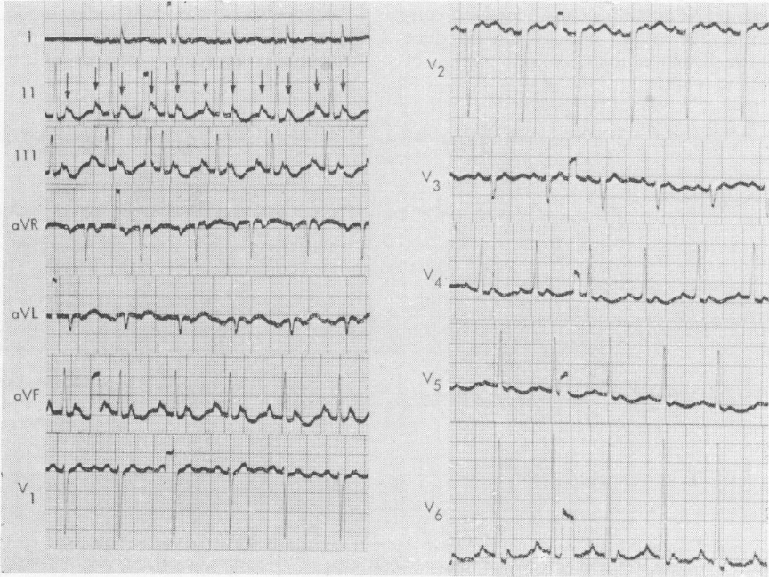
Digitalis Toxicity
Calcium overload → Increased automaticity
Increased vagal tone → AV block
Added together, classic arrhythmia: PAT with block

Slide 39
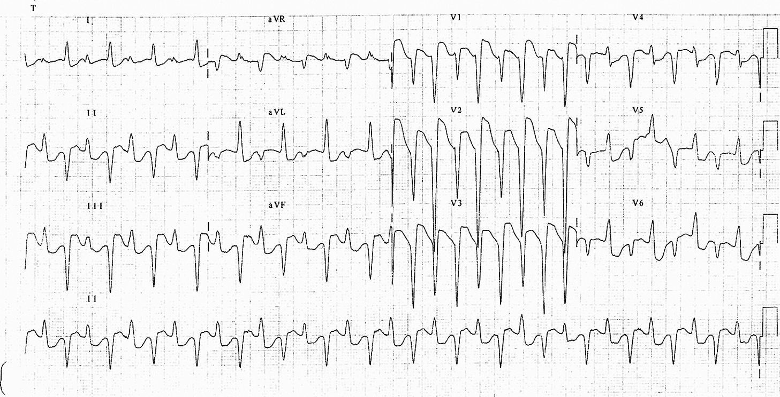
Digitalis Toxicity Arrhythmias
Sinus: bradycardia, tachycardia, block, arrest
Atrial tachycardia with block
Slow ventricular response or regularization (complete heart block) in atrial fibrillation/flutter
AV block: first, second (Mobitz type I), third degree
Junctional: rhythm, tachycardia, bradycardia
Ventricular: premature beats (common, often bigeminy), tachycardia, fibrillation, bidirectional VT

Slide 40
“VT or Not VT…”

Slide 41
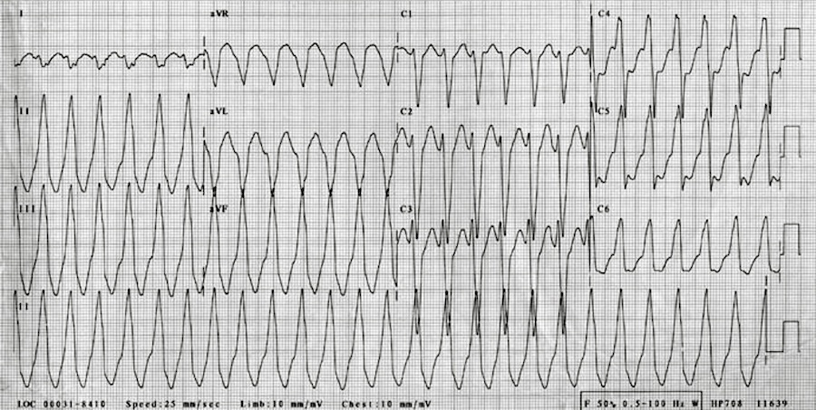
25/F with severe palpitations. What is the most likely diagnosis?
Sinus tachycardia with pre-existing bundle branch block
Ventricular tachycardia
Atrial tachycardia with aberrant conduction
Antidromic atiroventricular reentry tachycardia (AVRT)

Slide 42
Idiopathic VT
Typically RV outflow tract location
Structurally normal hearts
Calcium overload with delayed after-depolarizations
Very sensitive to adenosine, verapamil; also β-blockers
Catheter ablation is curative
Left bundle morphology
Inferior axis

Slide 43
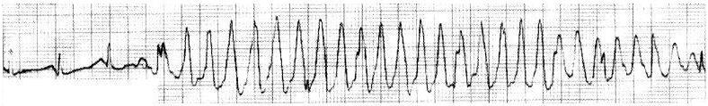
60/F without symptoms, RRT called for above rhythm strip; what is the next best step in management?
Immediate synchronized cardioversion
Reassurance
IV amiodarone
Transvenous pacemaker placement

Slide 44
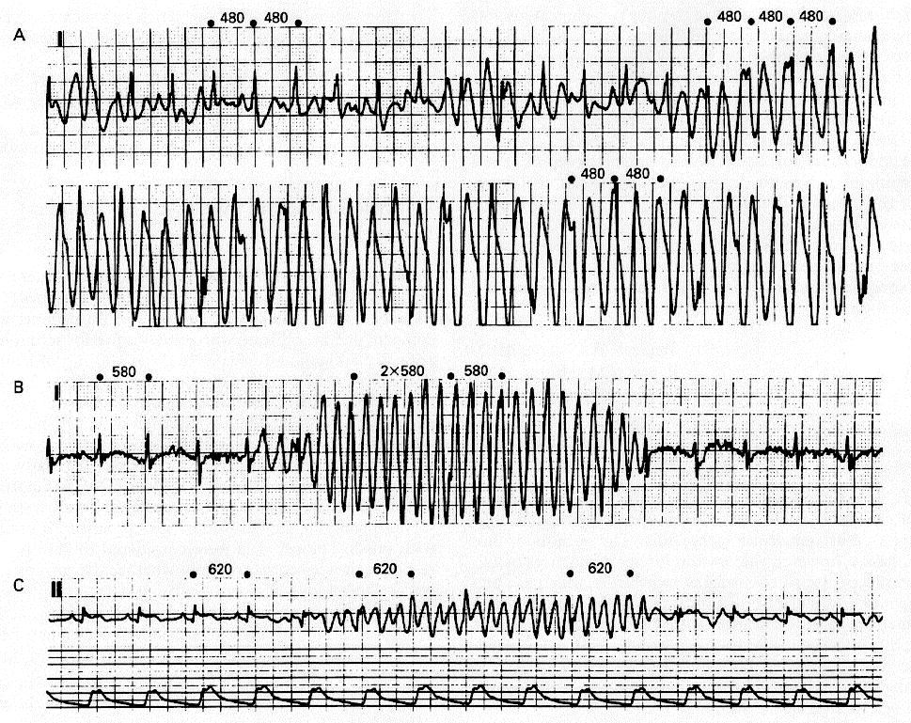
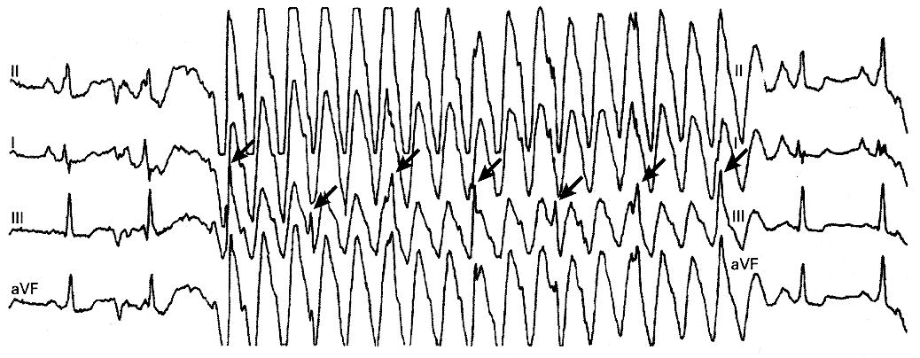
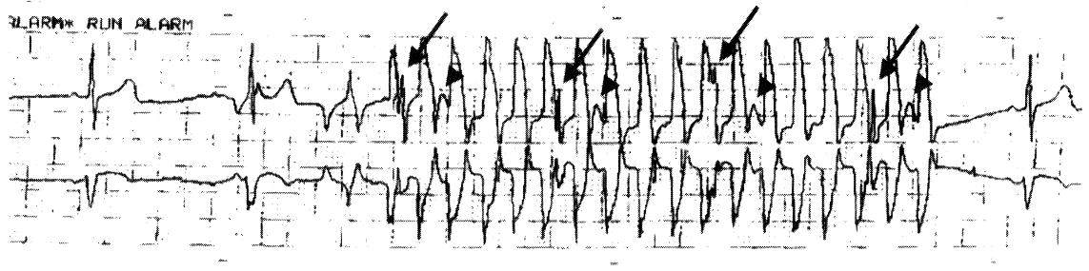
Artifact Simulating VT

Slide 45
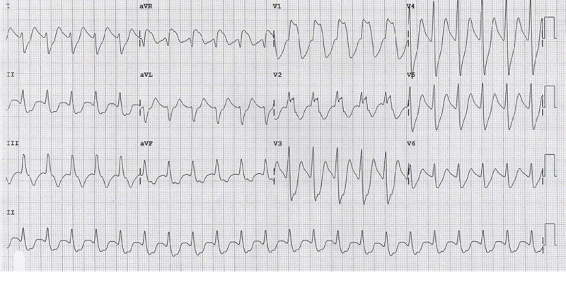
25/M with confusion, altered mentation, hypotension. What is the best treatment?
Intravenous phenytoin
Intravenous calcium
Intravenous sodium bicarbonate
Intravenous naloxone and flumazenil

Slide 46
Tricyclic Overdose
Terminal portion of frontal plane QRS axis is extremely rightward
QRS widening
QRS >100 msec or ventricular arrhythmias are indications for IV sodium bicarbonate

Slide 47
“My Chest Hurts”

Slide 48
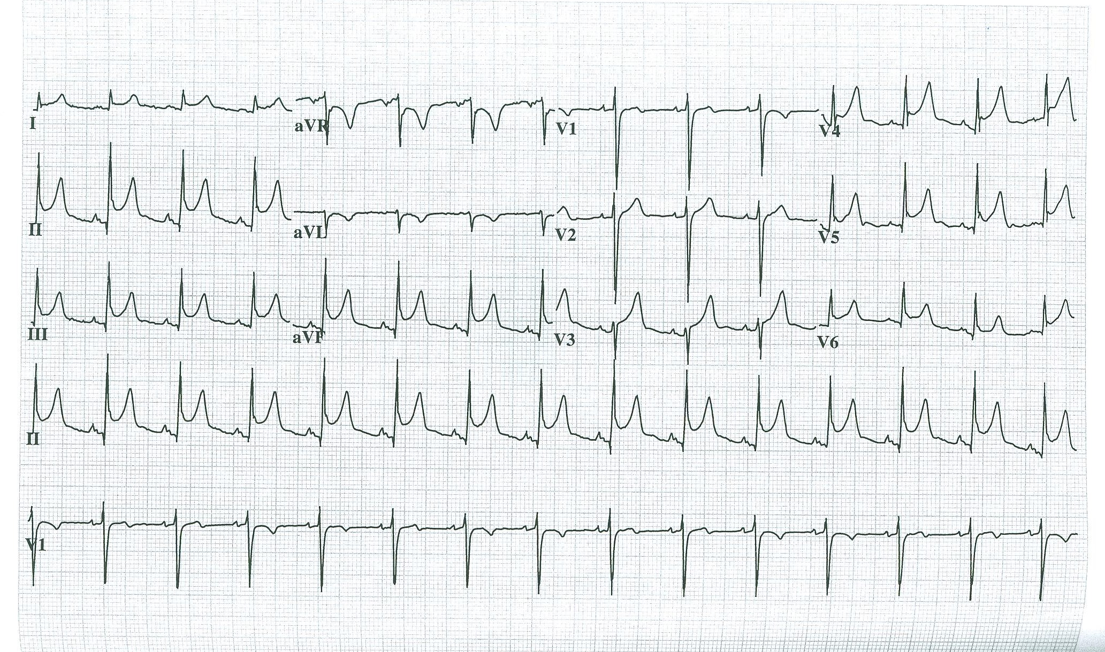
59/M with severe chest pain. What is the most appropriate treatment?
Emergency coronary angiography and primary percutaneous coronary intervention
Colchicine and high dose ibuprofen
Prednisone
Aspirin, clopidogrel, and intravenous heparin

Slide 49
Acute Pericarditis
PR segment elevation and ST depression in aVR
PR segment depression
Downsloping TP segment
Diffuse ST elevation

Slide 50
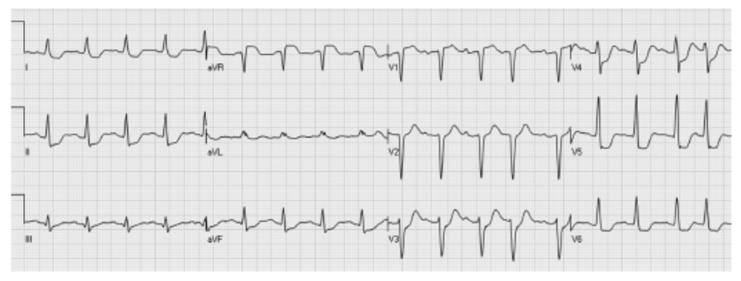
Which of the following is this ECG typically associated with?
Benign prognosis without therapy
Genetic predisposition to ventricular arrhythmias
Tricyclic antidepressant overdose
Circumferential subendocardial ischemia

Slide 51
Left Main/3-Vessel Disease Pattern
Widespread ST segment depression (usually 6 or more leads)
ST segment elevation in aVR
Suggests global subendocardial ischemia

Slide 52
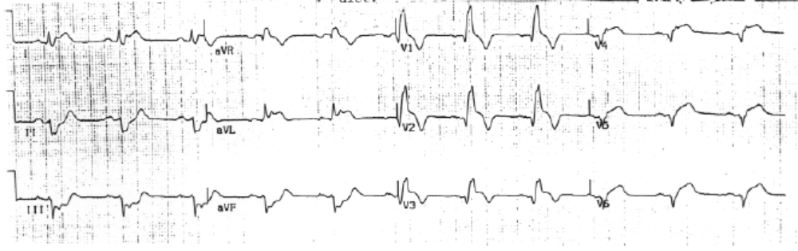
72/F with chest pain; what is the most likely diagnosis?
Secondary repolarization abnormalities due to RBBB
Acute anterolateral MI with RBBB
Benign early repolarization
LBBB with secondary repolarization abnormalities

Slide 53
Acute Anterior MI with RBBB
Q waves, ST elevations, evolving T wave inversions (extensive anterolateral, upward arrows)
Note reciprocal (mirror image) inferior changes (downward arrows)

Slide 54
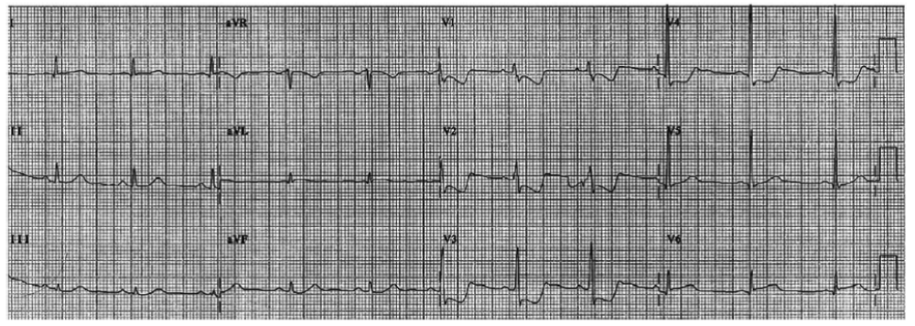
66/F with chest pain; what is the most likely diagnosis?
Acute posterior MI
Acute pulmonary embolism
Right ventricular hypertrophy with associated repolarization abnormalities
Pseudo-infarct pattern due to WPW syndrome

Slide 55
Acute Posterior MI
ST depressions in anterior precordial leads
Often with tall R waves in V1-V2
If flip the QRS-T upside down, looks like Q wave and ST elevation

Slide 56
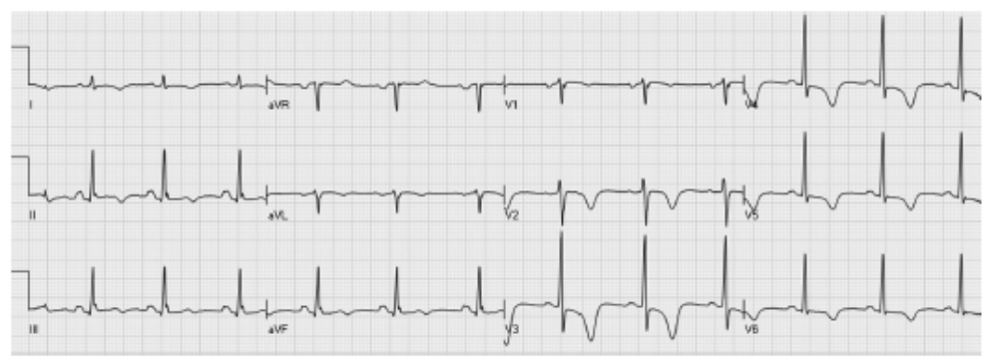
70/M with multiple cardiac risk factors presents with typical unstable angina; what is the next best step in management?
Fibrinolysis
Intravenous calcium gluconate, insulin, and D50W
Coronary angiography with possible PCI
Exercise treadmill test

Slide 57
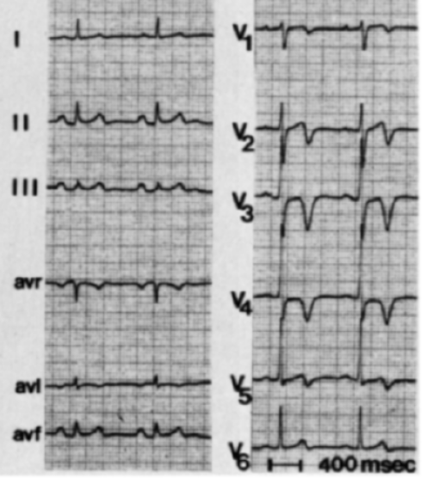
Wellens’ Sign
From Wellens’ original paper
Deep symmetric anterior precordial T wave inversions
Suggests severe LAD disease in patients who present with unstable angina

Slide 58
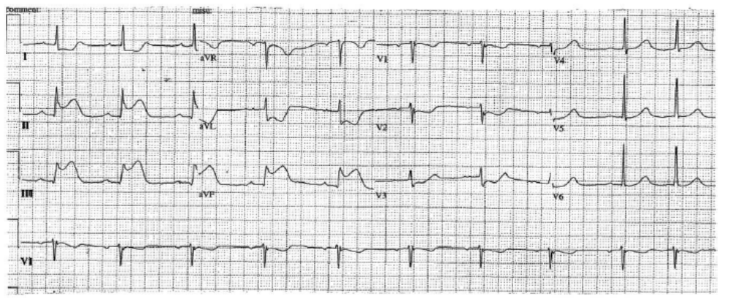
55/M smoker presenting with nausea, episgastric discomfort; what is the next best step in management?
Trial of antacid therapy
CT scan of the abdomen/pelvis
Upper endoscopy
Emergency coronary reperfusion

Slide 59
Acute Inferior MI
STE in inferior leads

Slide 60
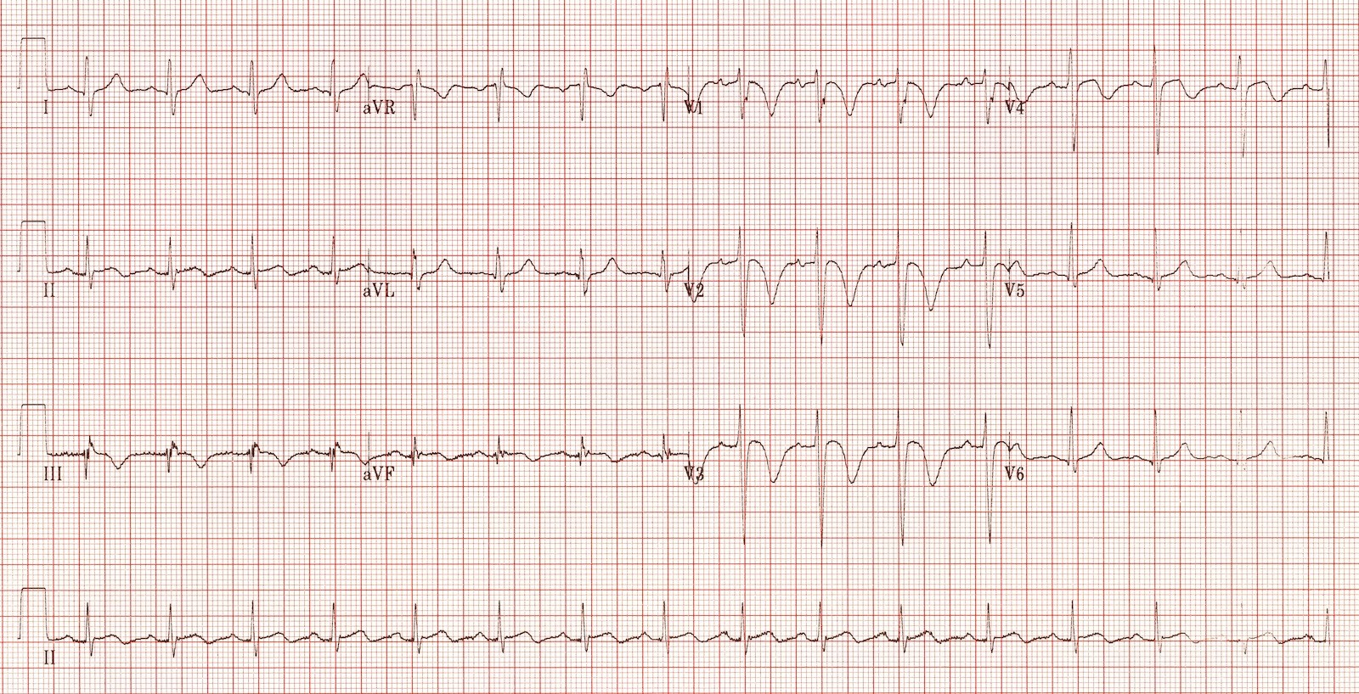
60/F with acute onset of dyspnea and chest pain one week after spine surgery. What is the most appropriate next step in management?
Computed tomographic pulmonary angiogram (CTPA)
Invasive coronary angiography
Transesophageal echocardiography
Electrophysiology study and genetic testing

Slide 61
Acute Pulmonary Embolism
Remember: Anterior precordial leads can also reflect changes in the RV
S1
RV strain pattern
Q3
T3
Others: Sinus tachycardia, nonspecific ST-T abrnm, RBBB, inferior Q waves

Slide 62
“Random Stuff”

Slide 63
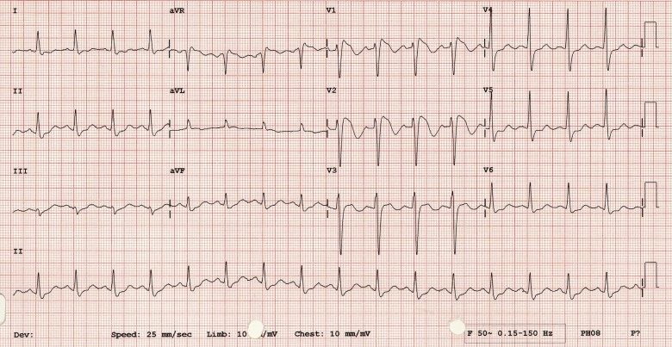
41/M survivor of sudden cardiac arrest; what are the likely findings on further cardiac testing?
Structurally normal heart
Thrombotic occlusion of the right coronary artery
Severe aortic stenosis
Dilated cardiomyopathy with severe LV systolic dysfunction

Slide 64
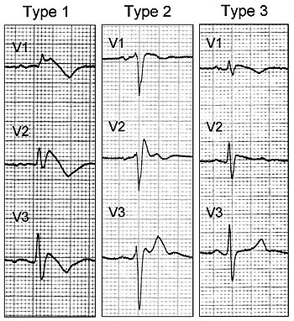
Brugada Pattern
Coved ST elevation >2 mm in V1-V3 (one or more), followed by negative T wave
For “syndrome” need clinical criteria and Type 1 pattern

Slide 65
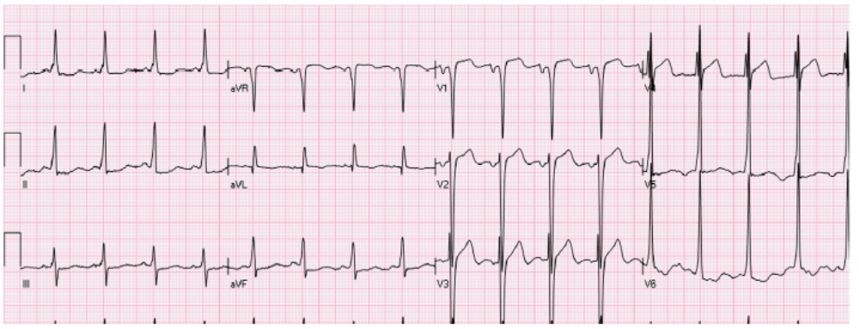
30/F with Ebstein’s anomaly and rapid palpitations; what is the best treatment option?
Tricuspid valve replacement
Verapamil
EP study and catheter ablation
Digoxin

Slide 66
Wolff-Parkinson-White Syndrome
Delta wave and short PR interval
Note: Like with Brugada, symptoms/clinical features are required before calling it “syndrome”
WPW syndrome = WPW pattern + symptoms

