Slide 1

Hemoptysis
Rainy Zhang, PGY-3

Slide 2
Case
43YO Hispanic woman with history of COVID+ in 11/2020, s/p vaccination, presents with LLQ pain a/w diarrhea and vomiting x 2 days
Also report hx of chronic sinus congestion and 1 month of dry cough with blood-tinged sputum in past few days
Noted hematuria for the first time during evaluation in ED
Born in San Jose, has 2 dogs and 1 bunny, worked at Costco pre-pandemic, last traveled to Mexico in 2019, lifetime non-smoker

Slide 3
Case
Vitals notable for mild hypertension 159/98, otherwise wnl
Exam:
  NAD, small amt of blood-tinged sputum on napkin
  Pale mucosa in nares without septal deviation or polyps
  BL tonsillar hypertrophy
  Diminished breath sounds, mild crackles on LLL
  No peripheral edema
  No joint swelling or rashes
Labs: Hb 7.6, Bicarb 15, BUN 63, Cr 7.6, INR 1, PTT 34
UA: 3+ protein, 3+ Hb, RBC >150

Slide 4
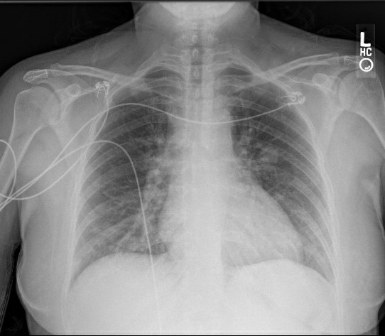
CXR
Patchy bilateral opacities in the mid to lower lung zones, suspicious for multifocal infection. Differential consideration includes Covid infection. Recommend follow-up to resolution.

Slide 5
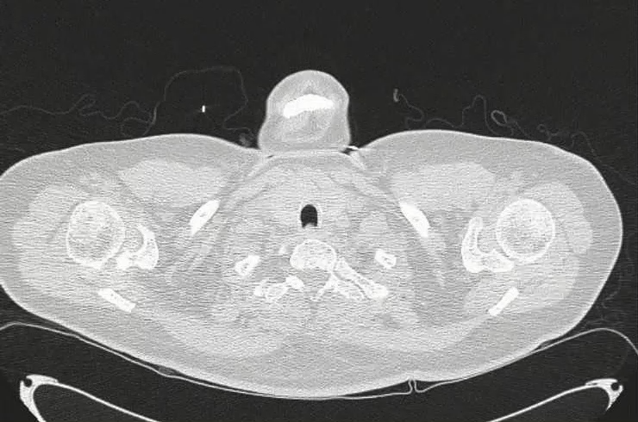
CT Chest wo contrast
Notes:
Solid and groundglass nodular opacities in the bilateral lungs in random distribution with associated intralobular septal thickening.

Slide 6
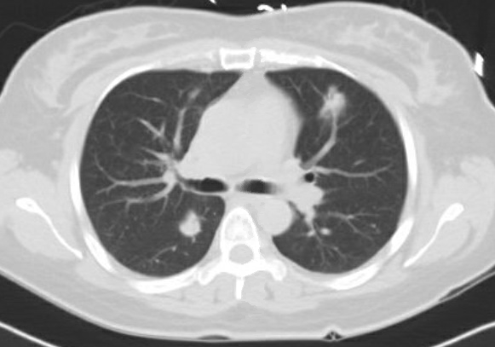
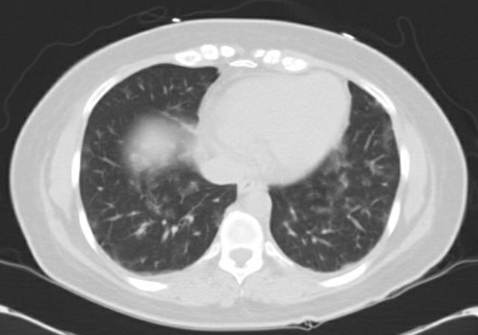
Case
Solid and groundglass nodular opacities in the bilateral lungs in random distribution with associated intralobular septal thickening.
Notes:
Solid and groundglass nodular opacities in the bilateral lungs in random distribution with associated intralobular septal thickening. Differential diagnosis includes hematogenous dissemination of infection or malignancy as well as vasculitis (especially Wegener)

Slide 7
Hemoptysis
Expectoration of blood from lower respiratory tract
Pseudohemoptysis
  Epistaxis
  Dental bleeding
  Hematemesis
Notes:
Hematemesis - a/w N/V, known liver or GI disease, brown/coffee ground
Hemoptysis – frothy, bright pink, known lung disease

Slide 8
Massive vs non-massive
Massive: large amount or rapid rate
  >150mL/24 hrs (1/2 cup of blood)
  Rate of >100cc/hr
  Only need about 150-200mL of blood to fill tracheobronchial tree
Life threatening vs non-life threatening
  Significant airway obstruction
  Significant abnormal gas exchange
  Hemodynamic instability
  Hypoxia, respiratory distress, shock

Slide 9
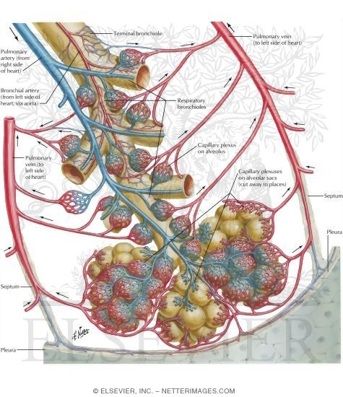
Dual blood circulation
Pulmonary artery
  Low-pressure system (from RV)
  Supplies lung parenchyma
  Most of non-life-threatening bleeds
Bronchial artery
  High-pressure system (from aorta)
  Supplies endobronchial tree
  2% of vascular supply of lung
  90% of life-threatening bleeds

Slide 10
Life-threatening hemoptysis
Rare (2-5%)
Etiologies
  Bronchiectasis
  Bronchogenic cancer
  TB
  Fungal infections
90% originates from bronchial circulation
Cause of death is asphyxiation > exsanguination

Slide 11
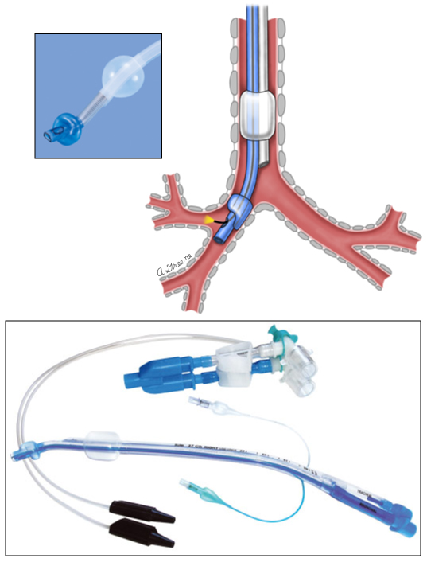
Life-threatening hemoptysis
Airway
  Intubate with ETT 8.0 for bronchs
  Avoid full-face noninvasive ventilation mask
  Single-lung ventilation vs double-lumen ventilation
Position
  ”Bad lung” down
Hemodynamics
Correct coagulopathy
Involve IR for embo or CT surgery for lobectomy
Notes:
Single-lung ventilation: ventilate good lung, protect from spilling from bad lung (R lung bleeding, intubate left lung)
Double-lumen ventilation: risk of malposition or repositioned with movement/cough, need to use small bronch
Balloon tamponade via working channel of bronch
Endobronchial blockers via ETT

Slide 12
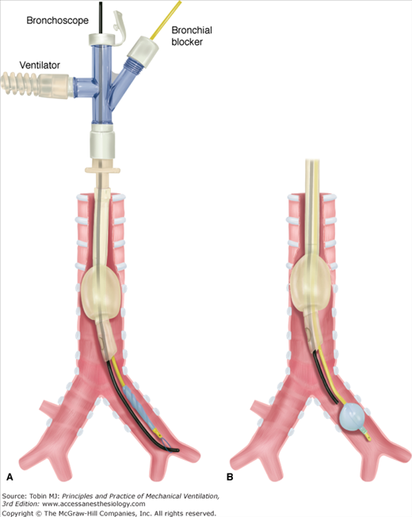
Life-threatening hemoptysis
Bronchoscopy: diagnostic study of choice
  Localize bleed
  Blood and thrombus removal
  Balloon tamponade/bronchial blockade

Slide 13
Non-life-threatening hemoptysis
Hemoptysis
Vascular
Airway
Other
Parenchyma
- PE
- CHF
- Vasculitis / SLE
- Valvular disease
- Bronchitis
- Bronchiectasis
- Malignancy
- Foreign body
- Iatrogenic
- Pneumonia (necrotizing)
- Lung abscess
- TB
- Mycetoma/fungal
- Bleeding disorder
- Trauma
- Catamenial
- Drugs/toxins

Slide 14
Non-life-threatening hemoptysis
Acute bronchitis
Bronchiectasis
Neoplasm
TB
Mycetoma
Notes:
Catamenial: intrathoracic endometriosis, recurrent a/w menses

Slide 15
Diagnosis and management
Labs
  CBC, Chem 7, UA, LFT, Coags
  Sputum culture (TB)
  Blood gas
  ANA, ANCA, anti-GBM
  BNP, D-dimer
CXR
CT chest WITH contrast (if stable)
Additional: CTA pulm arteries, TTE
Notes:
Hx
Smoking history, including vape
Hx of bleeding disorder
NSAIDs/antiplatelet/anticoagulation
Immobility, cancer, recent surgery
Systemic sx – rash, arthralgia, hematuria
Recent thoracic procedure
Exposure to TB, asbestos, or radiation

Slide 16
Bronchoscopy
Obtain labs and CXR/CT chest first
If need airway inspection, investigate area of concern on imaging, tissue biopsy, BAL
Tx: iced saline lavage, topical Epi, ablative tx (laser, electrocautery, APC, cryotherapy)

Slide 17
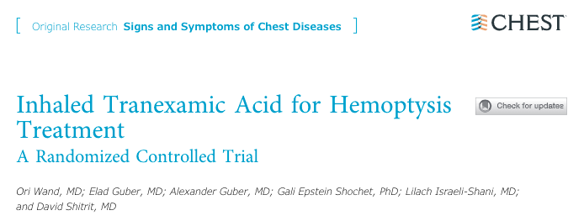
2008, Double-blind RCT
n = 47
Nebulized TXA 500 mg TID x up to 5 days (n = 25) vs placebo (n = 22)
Exclusion: massive hemoptysis (>200mL/24 hrs) and hemodynamic or respiratory instability were excluded
Results
  TXA group with reduced expectorated blood volume starting day 2
  Resolution of hemoptysis within 5 days (p < 0.0005)
  Shorter hospital LOS (p = 0.46)
  Fewer invasive procedures (interventional bronch and embo) (p = 0.41)
  No difference in mortality rates
  Reduced recurrence rate at 1 year follow up (p = 0.009)

Slide 18
Case
Very minimal hemoptysis and worsening AKI
Infectious work up, including TB, negative to date
Normal complements, negative anti-GBM, anti-dsDNA negative
ANA 1:320, speckled pattern
+ANCA

Slide 19
Vasculitides
Lungs + kidneys
Pauci-immune/ANCA
Anti-GBM (ie. Goodpasture Syndrome)
Behcet syndrome

Slide 20
ANCA vasculitis
Immunofluorescence staining of tissue – pauci-immune vs immune-mediated complex
ANCA: anti-neutrophil cytoplasmic autoantibodies
  IF staining of neutrophil/monocyte reveals pattern
  c-ANCA: cytoplasmic
  p-ANCA: perinuclear
3 types
  GPA: granulomatosis with polyangiitis
  eGPA: eosinophilic granulomatosis with polyangiitis
  Microscopic polyangiitis
Notes:
C-anca: uniform cytoplasmic staining, nucleus = dark, cytoplasm = green
p-anca: perinuclear staining with nuclear extension, parts of both nucleus and cytoplasm stains

Slide 21
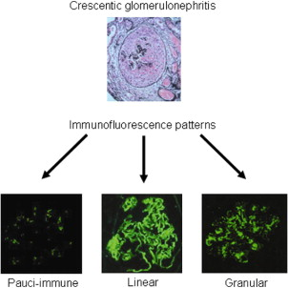
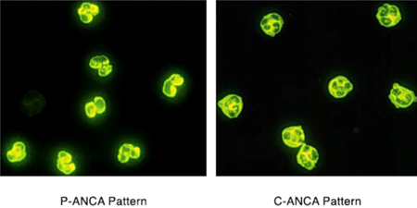

Slide 22
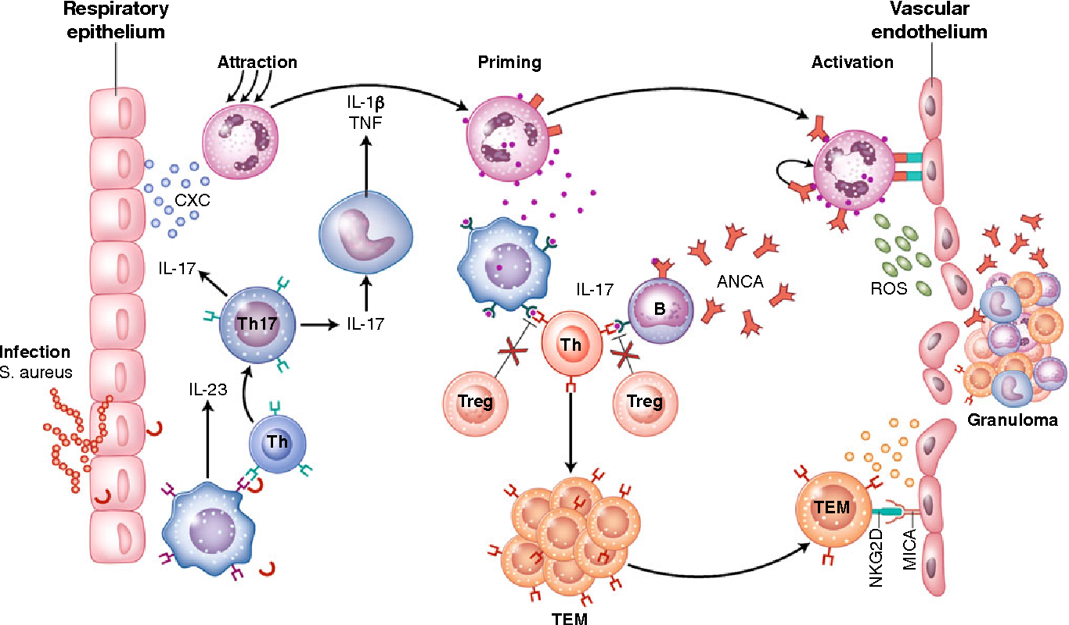
ANCA vasculitis
Autoantibodies in serum detected by ELISA
  Anti-proteinase 3 (PR3) Ab = c-ANCA
  Anti-myeloperoxidase (MPO) Ab = p-ANCA
Pathophysiology
  Acute inflammation -> cytokines: IL-1, TNFa -> induce translocation of antigens MPO/PR3 to surface of neutrophils -> autoAb (ie ANCA) binds to antigens -> more cytokine release (ROS) -> inflammation in blood vessels

Slide 23
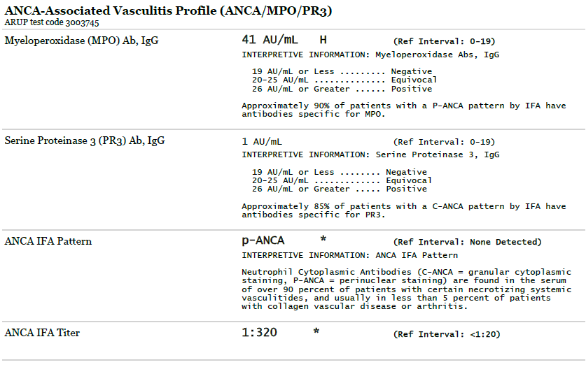
ANCA panel

Slide 24
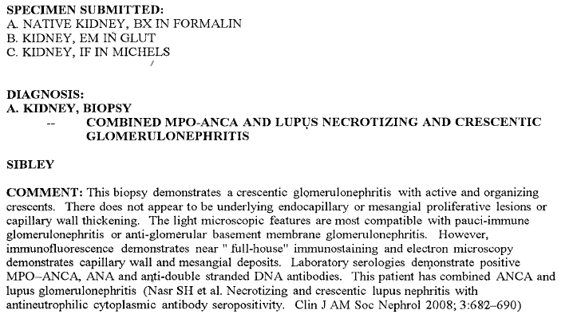
Kidney biopsy
Notes:
2008 case series with 10 cases
Prelim read: LM > 30 gloms sampled, 20 with both cellular and fibrous crescents and 10 globally sclerosed. No mesangial proliferation. All consistent with pauci immune crescentic GN.
- However, IF also shows full house staining. Given her presentation, and lack of other lupus like sx's, unifying diagnosis would be pauciimmune GN with lupus ab overlap. Await EM and serologies.

Slide 25
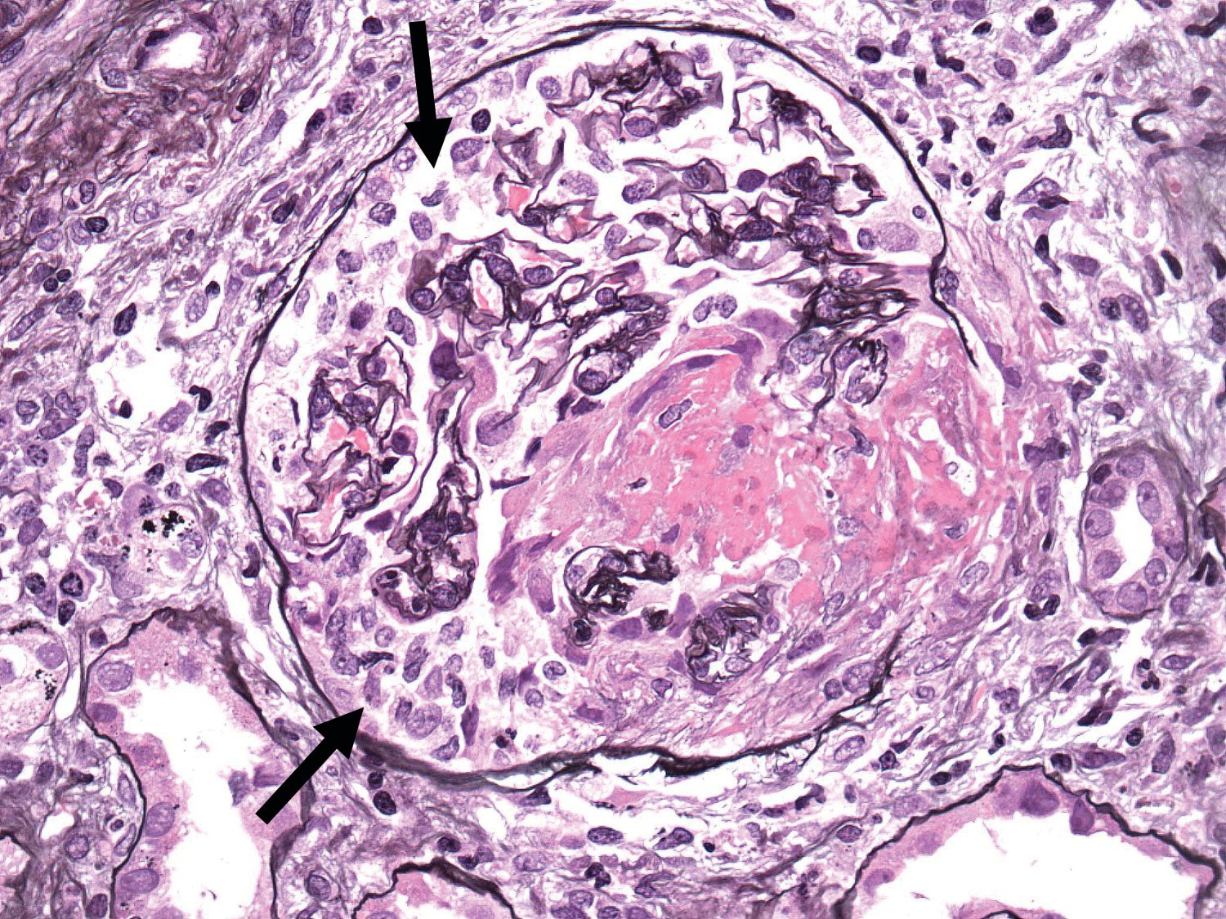
Diagnosis and treatment
Biopsy of kidney, lung nodule, skin lesions
Kidney
  Pauci-immune necrotizing GN
  Extensive glomerular crescents in RPGN
Treatment
  Induction: steroids + rituximab vs cyclophosphamide
  Maintenance: azathioprine vs MTX vs mycophenolate
Prognosis
  c-ANCA with significantly higher rate of relapse than p-ANCA
  ANCA-associated GN
    20% morality rate in 1st year of diagnosis
    25% surviving patients with ESRD within 4 years
Notes:
- Pulse steroids 500mg IV qd x 3 (8/18-20)
- prednisone 1mg/kg/day ~60mg daily
- plan for rituximab infusion weekly for 4 weeks (received first dose 8/20)

Slide 26
Summary
Evaluate for true vs pseudohemoptysis
Majority of lungs supplied by pulmonary arteries but majority of massive hemoptysis originate from bronchial arteries
If massive/life-threatening, ABCs
  Call IR early!
Most common cause is acute bronchitis
Inhaled TXA for non-life-threatening bleed
If kidney involvement, suspect vasculitides

